Slide 1
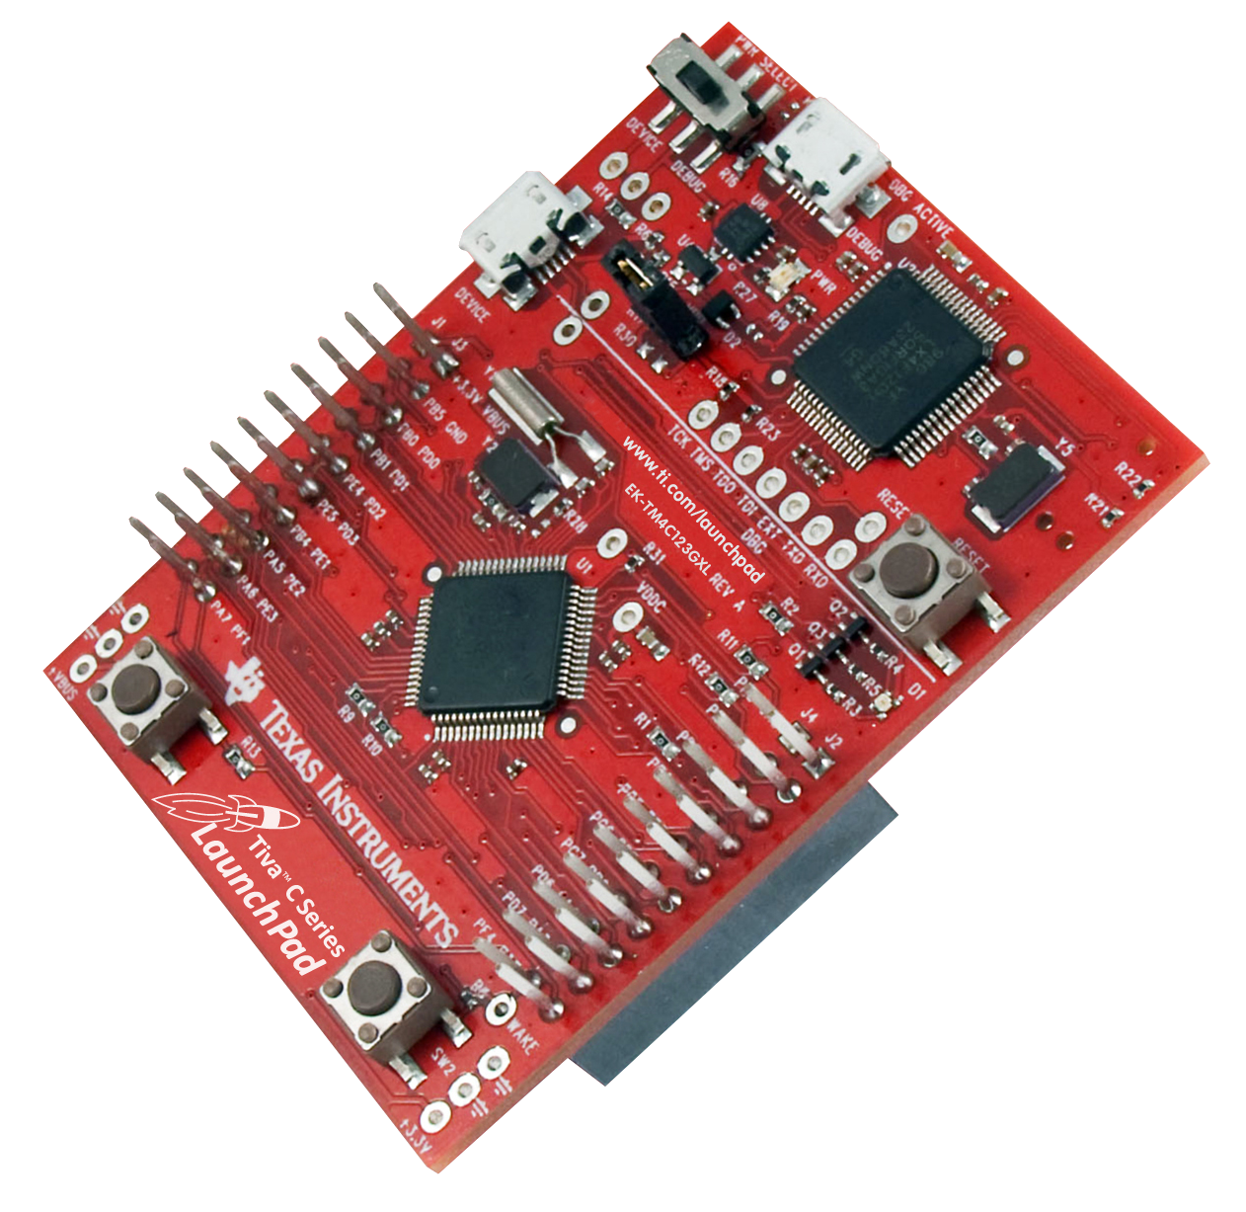
Getting Started With the Tiva™ C Series TM4C123G LaunchPad Workshop
Version 1.21
Notes:
This workshop has been constructed to be extensively hands-on, and the overwhelming majority of your time will be spent working with the tools and writing code. If you don't already have some experience with embedded microcontrollers and using the C programming language, you need to acquire that experience before proceeding. There are many resources online that you can use to obtain that knowledge.
In case you didn't know it already, this workshop is available at http://www.ti.com/TM4C123G-Launchpad-Workshop . That wiki site has links to all of the material you need to run this workshop.

Slide 2

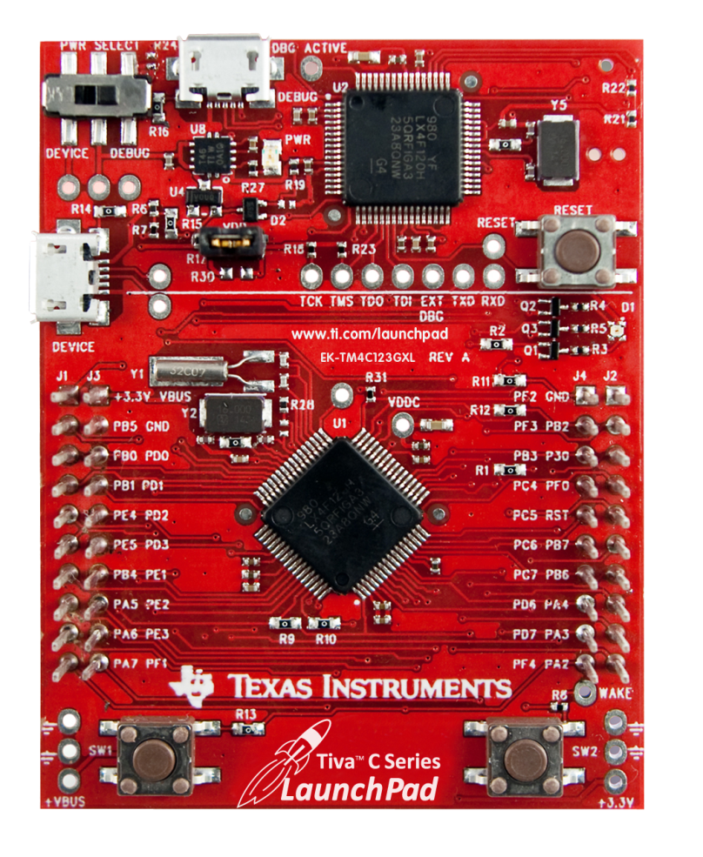
Agenda
Introduction to ARM® Cortex™-M4F and Peripherals
Code Composer Studio
Introduction to TivaWare™, Initialization and GPIO
Interrupts and the Timers
ADC12
Hibernation Module
USB
Memory and Security
Floating-Point
BoosterPacks and grLib
Synchronous Serial Interface
UART
µDMA
Sensor Hub
PWM
Portfolio ...
Notes:
Chapter one is an introduction to TI's Tiva C Series Cortex-M4F microcontroller and its peripherals and tools. You'll examine the architecture and features of the device and the design of the LaunchPad board.

Slide 3
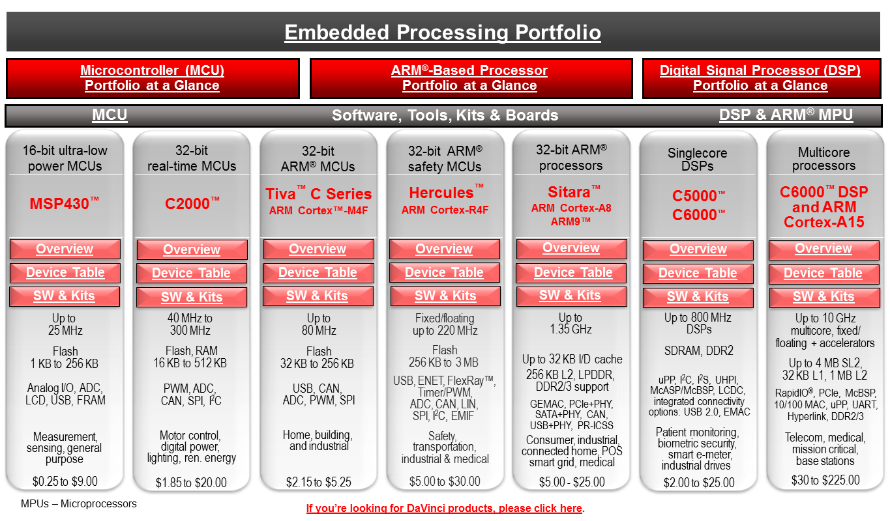
TI Embedded Processing Portfolio
TM4C123G MCU ...
Notes:
3
3
3
3
3
3
T I’s embedded processing portfolio is exceptionally wide . From the 16 bit ultra-low power MSP430 microcontrollers on the left to multicore C6000 DSP’s and high-end Cortex A-15 devices on the right.
In the middle are our 32 bit Real-Time C2000 processors . These parts are extensively used in motor control, digital power , lighting and renewable energy.
Hercules parts are 32 bit ARM Cortex-R4F devices configured specifically for safety, transportation , industrial , and medical uses .
Sitara parts are 32 bit ARM Cortex-A8 and A9 processors with speeds to 1.35 GHz. These parts see use in consumer, industrial , connected home , point of sale , smart grid and medical applications . These parts are capable of running high-end operating systems.
C5000 and C6000 processors are available as single core DSPs. These devices are often embedded in consumer electronics and industrial applications.
Today we will be looking at the Tiva C series devices . These ARM Cortex-M4F devices include serial connectivity and measurement peripherals. They are extensively used in Home Automation , building automation and industrial applications .

Slide 4
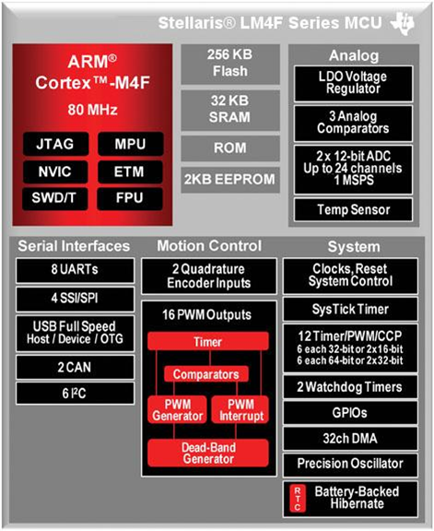
Tiva™ TM4C123G Microcontroller
Low power consumption
As low as 370 µA/MHz
500µs wakeup from low-power modes
RTC currents as low as 1.7µA
Internal and external power control
Core and FPU ...
Notes:
Tiva C Series microcontrollers have a wide range of peripherals and capabilities. In the figure on the left-hand side, we can see the ARM Cortex M4F core, which supports JTAG access, as well as serial wire debug for testability.
Within the M4F is the NVIC or Nested Vectored Interrupt Controller, the MPU or memory protection unit and the FPU or floating point unit. ETM is the embedded trace macrocell for extended testing on the device.
The TM4C123H6PM device has 256K of flash, 32K of SRAM, 2K of EEPROM and an onboard ROM. I'll talk about the ROM contents in a moment..
On the analog side, there is a LDO voltage regulator for regulating the CPU voltage on the device, and 3 analog comparators. There are two, 1Msps 12-bit ADCs. 24 input channels are connected through 12 shared inputs on this device and there is an onboard temperature sensor.
On the lower left are the serial interfaces. As many as eight UARTs, four SSI or SPI ports, a USB Host/Device and On-the-Go port, 2 CAN ports, or as many as 6 I²C ports. In each case I said “as many as” because most of the 64-pins on this device are heavily multiplexed and the number of peripherals that reach the pins will be determined by your decision with regard to that.
In the lower middle are the motion control modules. These modules provide 16 PWM outputs with dead band generation for H bridge circuitry protection . Two quadrature encoder inputs are included .
On the lower right are the clocks, reset and system control . The clock tree is very flexible on these devices . Below that is the SysTick timer which can be used as a general-purpose timer or as the heartbeat timer for an operating system. Below that are the 12 general-purpose timers . These can be configured for PWM or capture and compare purposes . They can also be flexibly set up as 16, 32 or 64 bit timers . There are two watchdog timers , each on a separate clock source . As many as 43 general-purpose I/O and a 32 channel DMA .There is a internal precision oscillator requiring no external components and a hibernate module that includes a Real-Time clock and battery-backed SRAM .
These parts have power consumption as low as 370 microamps per megahertz, 500 microseconds wake-up from low power modes, and realtime clock currents as low as 1.7 microamps. Power control is provided for both internal and external circuitry .

Slide 5

M4 Core and Floating-Point Unit
32-bit ARM® Cortex™-M4 core
Thumb2 16/32-bit code: 26% less memory & 25 % faster than pure 32-bit
System clock frequency up to 80 MHz
100 DMIPS @ 80MHz
Flexible clocking system
Internal precision oscillator
External main oscillator with PLL support
Internal low frequency oscillator
Real-time-clock through Hibernation module
Saturated math for signal processing
Atomic bit manipulation. Read-Modify-Write using bit-banding
Single Cycle multiply and hardware divider
Unaligned data access for more efficient memory usage
IEEE754 compliant single-precision floating-point unit
JTW and Serial Wire Debug debugger access
ETM (Embedded Trace Macrocell) available through Keil and IAR emulators
Memory ...
Notes:
Tiva C series devices are built with a 32 bit AR M Cortex – M4 core. This core runs the Thumb2 instruction set. This instruction set uses both 16 and 32-bit instructions . It uses 26% less memory and is 25% faster than pure or 32-bit code.
With a clock frequency of up to 80 MHz the core delivers 100 DMIPS at 80 MHz . The part has a very flexible clocking system with an internal precision oscillator , an external main oscillator with PLL support , an internal low-frequency oscillator and a Real-Time clock through the hibernation module .
For signal processing applications the core implements saturated math instructions . Read – modify – write operations are atomic and use the bit banding technique that we’ll cover later .
There is a single cycle multiply and a hardware divider. Data access is unaligned for more efficient memory usage .
The single-precision floating point unit is IEEE – 754 compliant . JTAG and serial wire debug debugger access is provided.

Slide 6
TM4C123GH6PM Memory
256KB Flash memory
Single-cycle to 40MHz
Pre-fetch buffer and speculative branch improves performance above 40 MHz
32KB single-cycle SRAM with bit-banding
Internal ROM loaded with TivaWare software
Peripheral Driver Library
Boot Loader
Advanced Encryption Standard (AES) cryptography tables
Cyclic Redundancy Check (CRC) error detection functionality
2KB EEPROM (fast, saves board space)
Wear-leveled 500K program/erase cycles
Thirty-two 16-word blocks
Can be bulk or block erased
10 year data retention
4 clock cycle read time
0x00000000 Flash
0x01000000 ROM
0x20000000 SRAM
0x22000000 Bit-banded SRAM
0x40000000 Peripherals & EEPROM
0x42000000 Bit-banded Peripherals
0xE0000000 Instrumentation, ETM, etc.
Peripherals ...
Notes:
There are four different kinds of memory on this device .
The 256 KB flash memory is single-cycle to 40 MHz . A pre-fetch buffer and speculative branching improves performance above 40 MHz .
The 32 KB single-cycle SRAM implements bit-banding that we will cover later .
The internal ROM is loaded with the TivaWare Peripheral driver library , the boat loader , cryptography tables and CRC error detection functionality.
The 2 KB EEPROM is wear-leveled to provide 500,000 program and erase cycles with a five year data retention. Random access requires four clock cycles while sequential access is single-cycle for each location after the first .
Note the figure on the lower right with flash memory starting out at zero , followed by ROM, SRAM , the bit-banded alias of the SRAM , peripherals and EEPROM , followed by the bit-banded alias of the peripherals and finally some additional locations.

Slide 7
TM4C123GH6PM Peripherals
Battery-backed Hibernation Module
Internal and external power control (through external voltage regulator)
Separate real-time clock (RTC) and power source
VDD3ON mode retains GPIO states and settings
Wake on RTC or Wake pin
Sixteen 32-bit words of battery backed memory
5 µA Hibernate current with GPIO retention. 1.7 µA without
Serial Connectivity
USB 2.0 (OTG/Host/Device)
8 - UART with IrDA, 9-bit and ISO7816 support
6 - I²C
4 - SPI, Microwire or TI synchronous serial interfaces
2 - CAN
More ...
Notes:
The part is equipped with a battery backed hibernation module . This module provides internal and external power control with the use of a external voltage regulator . The hibernation module supplies a separate real-time-clock and a battery power source . The VDD3ON mode retains the states of the external pins during hibernation to prevent errors or damage to external circuitry. Waking from hibernation can be done on a Real-Time clock match or by toggling the wake pin. 16 32 bit words of battery-backed SRAM are provided within the hibernation module . When configured for GPIO retention hibernation current is 5uA. Without GPIO retention and with the Real-Time clock running it is1.7 uA.
Serial connectivity to the part is provided through a USB 2.0 OTG/Host/Device port, eight UART ports, six I²C ports, four Synchronous Serial ports and two CAN ports .

Slide 8
TM4C123GH6PM Peripherals
Two 1MSPS 12-bit SAR ADCs
Twelve shared inputs
Single ended and differential measurement
Internal temperature sensor
4 programmable sample sequencers
Flexible trigger control: SW, Timers, Analog comparators, GPIO
VDDA/GNDA voltage reference
Optional hardware averaging
3 analog and 16 digital comparators
µDMA enabled
0 - 43 GPIO
Any GPIO can be an external edge or level triggered interrupt
Can initiate an ADC sample sequence or µDMA transfer directly
Toggle rate up to the CPU clock speed on the Advanced High-Performance Bus
5-V-tolerant in input configuration (except for PB0/1 and USB data pins when configured as GPIO)
Programmable Drive Strength (2, 4, 8 mA or 8 mA with slew rate control)
Programmable weak pull-up, pull-down, and open drain
More ...
Notes:
There are two 1Msps 12-bit successive approximation analog-to-digital converters on the device . These two ADCs share 12 inputs and can make single-ended and differential measurements . There is an internal temperature sensor and four programmable ADC sample sequencers . Flexible trigger control allows you to start a conversion sequence with software, the timers , the analog comparators or with an external pin. Because of the device’s low pin count, only the VDDA to GNDA voltage reference is provided . There is optional hardware averaging , two analog and 16 digital comparators. DMA support is provided.
The device has as many as 43 GPIO depending on which peripherals you choose to bring out to the pins . Any GPIO can be an external edge or level triggered interrupt and can directly initiate an ADC sample sequence or DMA transfer.The toggle rate can be as high as the CPU clock speed when using the advanced high-performance bus . Inputs are 5V tolerant (with a few exceptions) and the drive strength of the outputs can be programmed to 2, 4, and 8mA. The 8mA setting provides slew rate control. All GPIO have programmable weak pull-up , pull-down and open-drain options .

Slide 9
TM4C123GH6PM Peripherals
Memory Protection Unit (MPU)
Generates a Memory Management Fault on incorrect access to region
Timers
2 Watchdog timers with separate clocks
SysTick timer. 24-bit high speed RTOS and other timer
Six 32-bit and Six 64-bit general purpose timers
PWM and CCP modes
Daisy chaining
User enabled stalling on CPU Halt flag from debugger for all timers
32 channel µDMA
Basic, Ping-pong and scatter-gather modes
Two priority levels
8,16 and 32-bit data sizes
Interrupt enabled
More...
Notes:
The memory protection unit or MPU provides up to 64 memory regions on the device that can be configured for access control . Incorrect access to one of these regions will generate a memory management fault .
There are two watchdog timers with separate clocks in case one of them fails , a 24 bit SysTick high-speed general-purpose or RTOS timer and six 32-bit and six 64-bit general-purpose timers . The general-purpose timers have PWM and capture and compare modes as well as daisy chaining. Timers can be configured to stall when the processor is halted by the debugger .
A 32 channel DMA provides basic, ping-pong and scatter gather modes with two priority levels . Data sizes can be 8, 16 and 32 bit. The DMA is interrupt enabled.

Slide 10
TM4C123GH6PM Peripherals
Nested-Vectored Interrupt Controller (NVIC)
7 exceptions and 71 interrupts with 8 programmable priority levels
Tail-chaining and other low-latency features
Deterministic: always 12 cycles or 6 with tail-chaining
Automatic system save and restore
Two Motion Control modules. Each with:
8 high-resolution PWM outputs (4 pairs)
H-bridge dead-band generators and hardware polarity control
Fault input for low-latency shutdown
Quadrature Encoder Inputs (QEI)
Synchronization in and between the modules
Board...
Notes:
The nested Vectored interrupt controller offers 7 system level exceptions and 65 interrupts with 8 programmable priority levels . The majority of the interrupts in the vector table can be re-programmed two any of these eight priority levels . Asynchronous interrupt latency is reduced through the use of a feature called tail chaining . Response is deterministic : it is always 12 cycles or six cycles when tail chaining is used . System save and restoration is completely automatic .
The device has two motion control modules . Each module has 8 high resolution PWM outputs configured in 4 pairs . Dead band generators and hardware polarity control make it easy to drive H bridge circuitry . Dedicated fault inputs allow low latency shutdown . System feedback is done using Quadrature encoder inputs . The motion control modules can operate independently or can be synchronized .

Slide 11
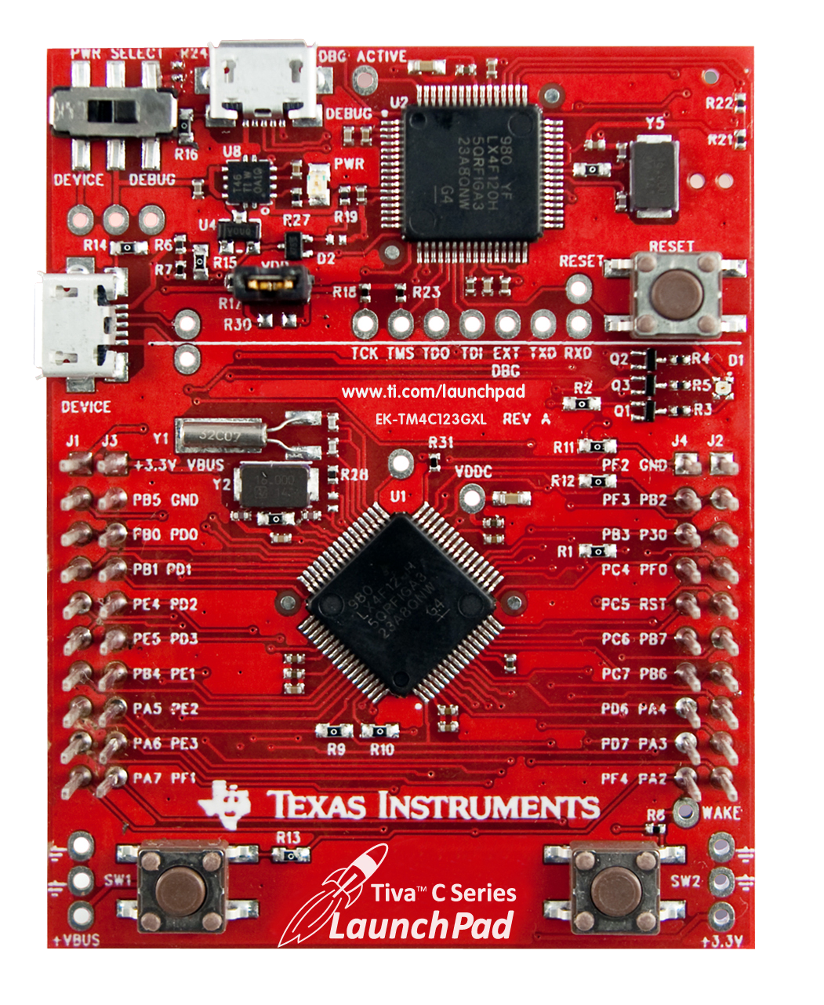


Tiva™ EK-TM4C123GXL LaunchPad
ARM® Cortex™-M4F 64-pin 80MHz TM4C123GH6PM
On-board USB ICDI (In-Circuit Debug Interface)
Micro AB USB port
Device/ICDI power switch
BoosterPack XL pinout also supports legacy BoosterPack pinout
2 user pushbuttons (SW2 is connected to the WAKE pin)
Reset button
3 user LEDs (1 tri-color device)
Current measurement test points
16MHz Main Oscillator crystal
32kHz Real Time Clock crystal
3.3V regulator
Support for multiple IDEs:
Lab...
Notes:
The TM4C123GXL LaunchPad board has some impressive features for a small price. The onboard processor is a Texas Instruments Tiva C Series TM4C123GH6PM microcontroller. It's a member of the ARM Cortex M4F family with 64 pins and has a top speed of 80 megahertz. The LaunchPad has two USB ports, one at the top for emulation and one of the left side as a OTG/Host and Device user port. The board can be powered through either port using the power switch in the upper left.
There are two user push buttons at the bottom of the board. The one on the right is also connected to the wake pin on the microcontroller that will wake it from hibernation mode. A reset button is provided in the emulator area of the board in the upper right.
Just below the reset button is a tricolor LED that combines the red, green, and blue LEDs into a single package. To the right of the device USB port are two test points where you can measure the current draw of the microcontroller. They are connected by a jumper.
There are two crystals on the board, a 16MHz one that drives the main oscillator and a 32,768-hertz one that drives the real-time clock oscillator. Since many computer USB ports can deviate significantly from 3.3 volts, an onboard voltage regulator is provided.
Expandability is an important aspect of all TI's LaunchPad boards. The Tiva LaunchPad features the booster pack XL pin out, which offers additional signals while still supporting existing booster packs.
All Tiva C Series devices offer support for multiple integrated development environments or IDEs. Mentor graphics, mentor-embedded, source recode bench, IAR systems embedded workbench, ARM, Keil Microvision IDE, and Texas Instruments Code Composer Student are all supported. Code Composer Studio, or CCS, will be our tool of choice in this workshop.

Slide 12

Lab 1: Hardware and Software Setup
USB Emulation Connection
Install the software
Review the kit contents
Connect the hardware
Test the QuickStart application
Agenda ...
Notes:
In lab one, you'll obtain and install all the needed hardware and software, as well as test out the pre-installed application software on the LaunchPad board.

Slide 13
Agenda
Introduction to ARM® Cortex™-M4F and Peripherals
Code Composer Studio
Introduction to TivaWare™, Initialization and GPIO
Interrupts and the Timers
ADC12
Hibernation Module
USB
Memory and Security
Floating-Point
BoosterPacks and grLib
Synchronous Serial Interface
UART
µDMA
Sensor Hub
PWM
IDEs...
Notes:
Chapter two is an introduction to Code Composer Studio Version 5.x. Code Composer Studio is an Integrated Development Environment, or IDE, that combines editing, debugging, and analysis tools into a single package. It's based on the Eclipse open source development tool. Before you can write code for the Tiva C Series device, you need to get acquainted with the tool you'll be using.

Slide 14

Development Tools for Tiva C Series MCUs
Eval Kit License | 30-day full function. Upgradeable | 32KB code size limited. Upgradeable | 32KB code size limited. Upgradeable | Full function. Onboard emulation limited
Compiler | GNU C/C++ | IAR C/C++ | RealView C/C++ | TI C/C++
Debugger / IDE | gdb / Eclipse | C-SPY / Embedded Workbench | µVision | CCS/Eclipse-based suite
Full Upgrade | 99 USD personal edition / 2800 USD full support | 2700 USD | MDK-Basic (256 KB) = €2000 (2895 USD) | 445 USD
JTAG Debugger |  | J-Link, 299 USD | U-Link, 199 USD | XDS100, 79 USD
TI SW Ecosystem …
Notes:
14
14
14
Tiva C Series microcontrollers are supported by four different integrated development environments: Mentor graphics Mentor-Embedded, IAR systems Embedded Workbench, ARM Keil Microvision, and Texas Instruments Code Composer Studio.
Each company offer different evaulation licenses. Some are code-size limited and others are time limited. Code Composer Studio is full function, but it's onboard emulation limited. When connected to the LaunchPad board it is fully functional and free. Only if you connect CCS to a target board will you need to buy it.
Some companies use the GNU compiler, while others use their own. TI’s compiler has been developed in-house over many years.
For the debugger and editor interface, two of the tools offer Eclipse support. Eclipse is an open source tool that is quite popular at this time, primarily because of the many third party tools available as add-ins.
The prices for upgrading to the full versions are shown in the chart. Code Composer Studio is $445US for the downloaded version. If you want the CD, it's $495US.
Most of the companies offer JTAG debuggers, and there are also quite a few third-party debuggers for sale as well.

Slide 15
TI Software and Tools Ecosystem
Run-Time Software
Development Tools
High-level OS support and TI-RTOS
OS Independent support and TI-Wares software packages
CCStudio™ Integrated Development Environment (IDE) and other IDEs
Optimizing compilers
Design Kits & Evaluation Modules
Support & Community
TI Design Network: off-the-shelf software, tools and services
Forums & Wikis
In-person and online training
Run-Time Software …
Notes:
Development tools like Code Composer and evaluation products like the LaunchPad board are just a part of TI’s support ecosystem for it’s processors.
Run-time software support includes TivaWare for C Series as well as TI’s RTOS called SysBios.
There is a rich community of support for TI’s products through the forums, e2e pages, Wikis, in-person and on-line training.

Slide 16
Run-Time Software
TI Wares: minimizes programming complexity w/ optimized drivers & OS independent support for TI solutions
Low-level driver libraries
Peripheral programming interface
Tool-chain agnostic C code
Available today
TI-RTOS: provides an optimized real-time kernel at no charge that works with TI Wares
Real-time kernel (SYSBIOS) + optimized for TI devices:
Scheduling
Memory management
Utilities
Foundational software packages (TI Wares)
Libraries and examples
TI RTOS available today
TI-RTOS
SYSBIOS
+
TI Wares
+
File systems
Network stack
USB
SDK
Software Development Kit
CCS Functional Overview …
Notes:
TI’s run time software support includes TI Wares and TI-RTOS
TI Wares like TivaWare minimize programming complexity with low level driver libraries and peripheral driver libraries. They can be used with multiple development environments.
TI’s RTOS is comprised of an optimized real-time kernel called SysBios. SysBios is optimized for TI devices and includes scheduling, memory management, instrumention and is fully compatible with TivaWare. Programming of USB and Ethernet ports is made easier with file systems and stacks.

Slide 17
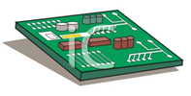
Code Composer Studio Functional Overview
Compiler
Standard Runtime Libraries
SYS/BIOS
Libraries
Target Config File
Simulator
.asm
.c
.lib
.ccxml
Edit
.asm
Assembler
.obj
Linker
.out
Debug
Emulator/ LaunchPad
. . .
SYS/BIOS
Config
(.cfg)
User.cmd
.map
.gel
Stand-Alone Emulator
Bios.cmd
Integrated Development Environment (IDE) based on Eclipse
Contains all development tools – compilers, assembler, linker, debugger, BIOS and includes one target – the Simulator
GEL files initialize the debugger so that it understands where memory, peripherals, etc. are
Target Board
Target configuration and Emulators…
Notes:
Code composer studio is an integrated development environment . This means that it contains the tools necessary to create , compile and debug software on your design .
CCS is based on the open source eclipse platform and is quite flexible and expandable .
A normal development flow would be to create C source files using the editor on the left . These files would then be compiled to create assembly files which are then assembled into relocatable object files . These object files, along with any libraries that you may include are linked into an output file using the guidance provided by the command file . The command file contains a list of all memories on the part, and what types of software should be placed within them .
Finally the debugger on the right uses the target configuration file and gel startup files to initialize and load your software onto your target device .
Code composer contains a simulator On which you can test your software . Evaluation boards like the launchpad contain their own built in emulator to connect CCS to the hardware . For target boards that do not contain an emulator , like any normal customers design , a stand-alone emulator must be provided . There are many available from TI and other third parties .

Slide 18
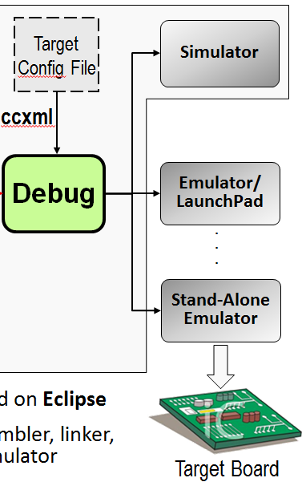
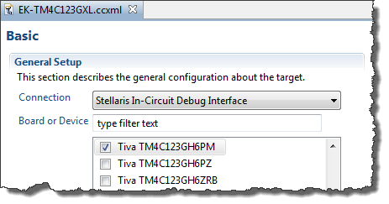
Target Configuration and Emulators
The Target Configuration File specifies:
Connection to the target (Simulator or Emulator type)
Target device
GEL file (if applicable) for hardware setup
Emulator (Connection) Options
Built-in and external emulators from TI, Blackhawk, Spectrum Digital and others
XDS100v1/v2, 200, 510, 560, 560v2
Projects and Workspaces …
Notes:
The target configuration file specifies the connection to your target . This target can be this emulator , and evaluation board /emulator combination Or a stand-alone emulator connected to a target .
The target device and the Emulator to be used must be specified .
If applicable , gel files can be used to initialize the hardware setup .

Slide 19
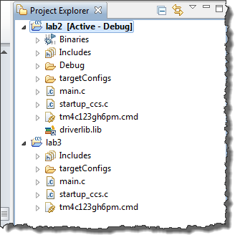
Projects and Workspaces (viewed in CCS)
PROJECT
Source
WORKSPACE
Projects and Workspaces …
Notes:
In eclipse, designs are organized into workspaces and projects .
This view in code composer studio is of the project explorer window . When you start code composer it will ask you what workspace you will be working in . The contents of that workspace will be shown in the project explorer window .
You can have many projects within the workspace and open and close them at will . The project explorer will show you the contents of the workspace and of the projects .

Slide 20
Projects and Workspaces
Workspace
Project 1
Project 2
Project 3
Settings/preferences
Project
Source Files
Header Files
Library Files
Build/tool settings
Link
Source Files
Code and Data
Link
Link
Header Files
Declarations
Link
Library Files
Code and Data
WORKSPACE folder contains:
IDE settings and preferences
Projects can reside in the workspace folder or be linked from elsewhere
When importing projects into the workspace, linking is recommended
Deleting a project within the Project Explorer only deletes the link
PROJECT folder contains:
Build and tool settings (for use in managed MAKE projects)
Files can be linked to or reside in the project folder
Deleting a linked file within the Project Explorer only deletes the link
Creating a New Project …
Notes:
This is a conceptual view of Workspaces and projects . Physically , both of these are merely folders on your computer .
The workspace folder contains code composer settings and preferences and projects that reside inside the workspace folder or that are linked from elsewhere . When you delete a linked project using project explorer , only the link will be deleted . When you delete a copied project using project explorer , the actual project will be deleted . Settings made at the workspace level effect all projects in the workspace
The project folder contains the build and tool settings for each project . Again files can be linked to or reside in the project folder . Deleting a linked file within the project explorer only deletes the late . A project can contain source files , which includes code and data, header files for declarations , library files and other settings .

Slide 21
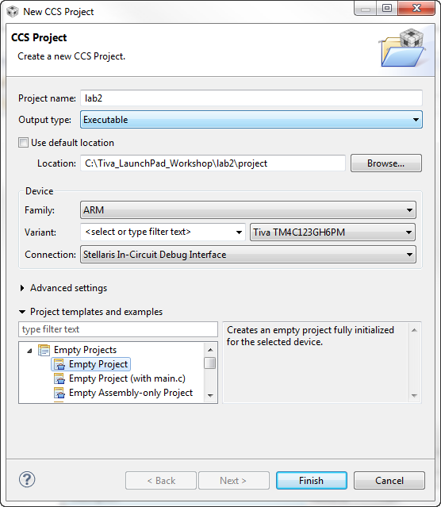
Creating a New Project
File New CCS Project
(in Edit perspective…)
Project Location
Default = workspace
Manual = anywhere you like
Connection
If target is specified, user can choose “connection” (i.e. the target configuration file)
Project templates
Empty
Empty but with a main.c
Assembly only
BIOS
others
Adding Files to a Project …
Notes:
To create a new project in code composer studio select file, new, CCS project from the menu bar . You’ll need to define the project location . This can be inside the workspace folder , or anywhere you like on the drive .
You then need to specify the connection to the target and the device that will be used . This information is used to create the target configuration file .
You can select from a number of project templates ; empty ones , empty but with a main template , an assembly project , a bios project and other example templates .

Slide 22
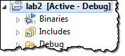
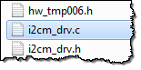
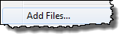
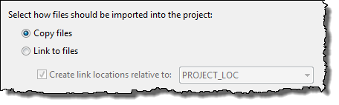
Adding Files to a Project
Users can ADD (copy or link) files into their project
SOURCE files are typically COPIED
LIBRARY files are typically LINKED (referenced)
1
Right-click on project and select:
2
Select file(s) to add to the project:
3
Select “Copy” or “Link”
COPY
Copies file from original location to project folder (two copies)
LINK
References (points to) source file in the original folder
Can select a “reference” point – typically PROJECT_LOC
Making a Project Portable …
Notes:
When you add files to your projects , you can either copy or link them . Source files are typically copied , while library files are typically linked or referenced.
To add a file to your project just for I click on the project name and select add files . You can then select the file or files that you want to add to the project . In the final step you decide whether a not to copy or link to the files . Copying will simply copy the file from its original location to the project folder . Linking references of source file in its original folder . You can select the link type whether relative to the project workspace or so on.

Slide 23
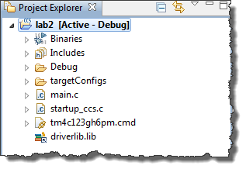
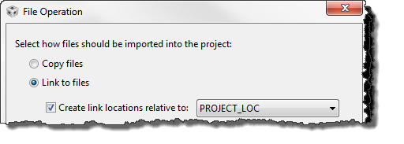
Portable Projects
Why make your projects “portable”?
Simplifies project sharing
You can easily re-locate your projects
Allow simple changes to link to new releases of software libraries
Copied files are not a problem (they move with the project folder)
Linked files may be an issue. They are located outside the project folder via a:
absolute path, or
relative path
This is the Path Variable for a relative path. This can be specified for every linked file.
Path and Build Variables …
Notes:
It is important to make your projects portable . Portable projects simplify the sharing of your work with colleagues or support staff . It makes it easier to relocate your project , if desired and when software libraries are updated , it is a simple change to link to them .
In the top figure , you can see that copied files are not a problem since they will move along with the project folder . Link files on the other hand may be an issue since they are located outside the project folder and are referenced by either an absolute or relative paths .
Note the path variable in the bottom figure for the relative paths, this is specified for every linked file .

Slide 24
Path Variables and Build Variables
Path Variables
Used by CCS (Eclipse) to store the base path for relative linked files
Example: PROJECT_LOC is set to the path of your project, say c:/Tiva_LaunchPad_Workshop/lab2/project
Used as a reference point for relative paths, e.g. ${PROJECT_LOC}/../files/main.c
Build Variables
Used by CCS (Eclipse) to store base path for build libraries or files
Example: CG_TOOL_ROOT is set to the path for the code generation tools (compiler/linker)
Used to find #include .h files, or object libraries, e.g. ${CG_TOOL_ROOT}/include or ${CG_TOOL_ROOT}/lib
How are these variables defined?
The variables in these examples are automatically defined when you create a new project (PROJECT_LOC) and when you install CCS with the build tools (CG_TOOL_ROOT)
What about TivaWare or additional software libraries? You can define some new variables yourself
Adding Variables …
Notes:
Two different kinds of variables are used ; path and build .
Path variables are used by CCS to store the base path for relative linked files . So the PROJECT_L OC Variable is set to the location of your project and can be used as a reference point for any other relative paths .
Build variables are used by CCS the store the base path for build libraries or files . CG_TOOL_ROOT is set to the path for the code generation tools which are the compiler and the linker. This is used to find your header files and any other object libraries.
These two variables are automatically defined when you create a new project and when you install code composer with the build tools .
TivaWare and any additional support libraries will require you to create some new variables yourself .

Slide 25
Adding Variables
Why are we doing this?
We could use PROJECT_LOC for all linked resources or PROJECT_ROOT as the base for build variables
It is “almost” portable, BUT if you move or copy your project, you have to put it at the same “level” in the file system
Defining a link and build variable for TivaWare location gives us a relative path that does NOT depend on location of the project (much more portable)
Also, if we install a new version of TivaWare, we only need to change these variables – which is much easier than creating new relative links
How to add Path and Build Variables
Project → Properties, expand the Resource category, click on Linked Resources. You will see a tab for Path Variables, click New to add a new path variable
Project → Properties, click on Build category, click on the Variables tab, Click New to add a new build variable
In the lab, we’ll add a path variable and build variable TIVAWARE_INSTALL to be the path of the latest TivaWare release
Note:
This method defines the variables as part of the project (finer control)
You can also define variables as part of your workspace (do it once)
Build Configurations …
Notes:
You could use the pre-defined variables to link all of your resources and this will create an almost portable project. Since the links in your projects are relative to these locations , if you move or copy your project you will have to put them at the same folder level in the file system . Defining a link and build variable for the TivaWare location will give us a relative path that does not depend on the location of the project . This is more portable . Also when the next version of TivaWare arrives , we only need to change these variables which is easier than creating new relative links .
On the CCS menu bar under project, properties expand the resource category and click on linked resources . You’ll see a tab for path variables , click new and add your new path variable .Again in the properties click on the build a category and then click on the variables tab. Click new, to add a new build variable .
In the lab, we’ll add a path variable and build variable called TIVAWARE_INSTALL that will point to the latest TivaWare release.
Note that you can defined variables to be part of your project , or you can define variables that will be part of your workspace and be a part of all projects within it .

Slide 26
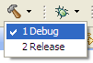
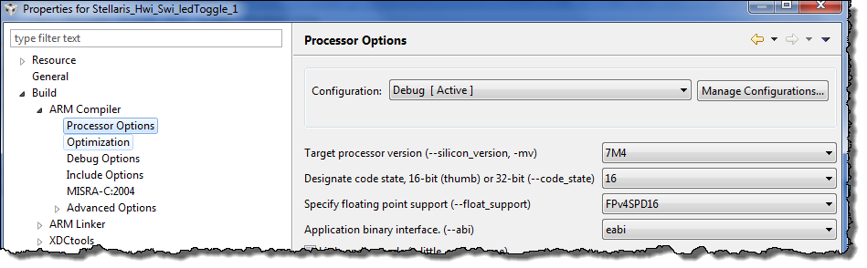
Build Configurations
Code Composer has two pre-defined BUILD CONFIGURATIONS:
Debug (symbols, no optimization) – great for LOGICAL debug
Release (no symbols, optimization) – great for PERFORMANCE
Users can create their own custom build configurations
Right-click on the project and select Properties
Then click “Processor Options” or any other category:
CCS Licensing and Pricing …
Notes:
Code Composer has two pre-defined build configurations ; debug and release .
The Debug Configuration is great for, as the name implies , debugging . It includes the symbol tables and no optimization .
The release configuration Is better for performance , but contains no simple tables and the code has been optimized . This can make debugging difficult or impossible .
You can create your own custom build configurations by right-clicking on the project and selecting properties . Then click processor options or any of the other categories that you want to change .

Slide 27
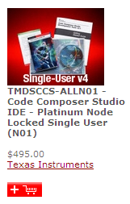
CCSv5 Licensing and Pricing
Licensing
Wide variety of options (node locked, floating, time based)
All versions (full, DSK, free tools) use the same image
Updates readily available online
Pricing
Includes FREE options noted below
Annual subscription - $99 ($159 for floating license)
Item | Description | Price | Annual
Platinum Eval Tools | Full tools with 90 day limit (all EMU) | FREE
Platinum Bundle | XDS100 use (EVM or simulator) | FREE *
Platinum Node Lock | Full tools tied to a machine | $495/$445 ** | $99
Platinum Floating | Full tools shared across machines | $795 | $159
MSP430 Code-Limited | MSP430 (16KB code limit) | FREE
* recommended option: purchase Development Kit, use XDS100v1-2, & Free CCSv5
** $495 includes DVD, $445 is download only
CCS FYI …
Notes:
There are a wide variety of options for licensing code composer studio . Licenses can be node locked, floating or time based . All versions , whether full , boards specific or free use the same image , they are simply licensed differently . Updates to co composer are readily available online .
The platinum evaluation tools are bundled are available for a free 90 day evaluation period. You can purchase a node locked license for either $445US for the download or $495US for the CD. The annual maintenance fee is $99US. The floating license is $795US with a $159US annual Maintenance fee .
The MSP430 16K code limited license is free .
Remember that code composer is free and fully functional when connected to the TM4C123G launchpad board .

Slide 28
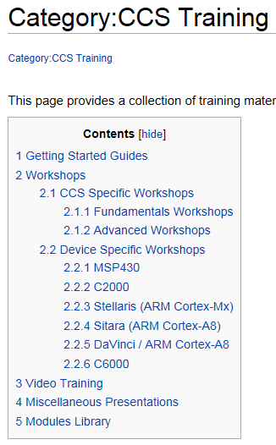
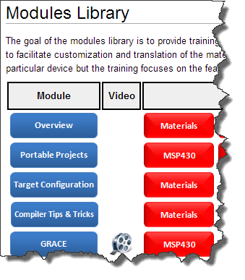
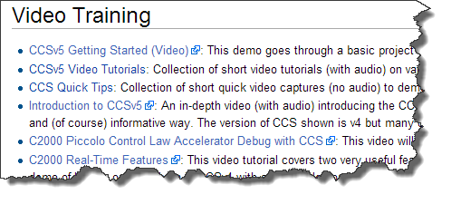
CCSv5 – For More Information
http://processors.wiki.ti.com/index.php/Category:CCS_Training
Lab …
Notes:
For additional training on code composer studio look to the menu bar for tutorials and the Wiki page shown for more detailed training . In this workshop we will barely scratch the surface of code composer’s abilities .

Slide 29
Lab 2: Code Composer Studio
USB Emulation Connection
Create a new project
Experiment with some CCS features
Use the LM Flash Programmer
Agenda ...
Notes:
In lab two, you'll start using Code Composer Studio. Don't get bogged down trying to understand the code. You'll get to that in the next lab. Here, just concentrate on the tool itself.

Slide 30
Agenda
Introduction to ARM® Cortex™-M4F and Peripherals
Code Composer Studio
Introduction to TivaWare™, Initialization and GPIO
Interrupts and the Timers
ADC12
Hibernation Module
USB
Memory and Security
Floating-Point
BoosterPacks and grLib
Synchronous Serial Interface
UART
µDMA
Sensor Hub
PWM
TivaWare...
Notes:
When you first start working with an evaluation board, like the LaunchPad, you want to do something simple, like make the LED blink. That implies you understand how to use the development tool, how to initialize the microcontroller and its clocks, and how to use the input/output pins. Chapter three and its lab will wrap all that together.

Slide 31

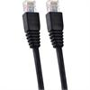
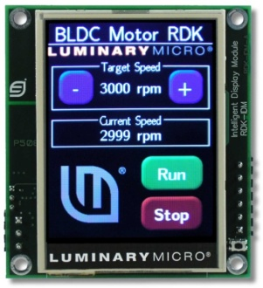
TivaWare™ for C Series Features
Peripheral Driver Library
High-level API interface to complete peripheral set
License & royalty free use for TI Cortex-M parts
Available as object library and as source code
Programmed into the on-chip ROM
USB Stacks and Examples
USB Device and Embedded Host compliant
Device, Host, OTG and Windows-side examples
Free VID/PID sharing program
Extras
Wireless protocols
IQ math examples
Bootloaders
Windows side applications
Ethernet
lwip and uip stacks with 1588 PTP modifications
Extensive examples
Graphics Library
Graphics primitive and widgets
153 fonts plus Asian and Cyrillic
Graphics utility tools
Sensor Library
An interrupt driven I²C master driver for handling I²C transfers
A set of drivers for I²C connected sensors
A set of routines for common sensor operations
Three layers: Transport, Sensor and Processing
ISP Options...
Notes:
31
31
31
TivaWare for C Series is a license and royalty-free set of code for TI Cortex M devices. It includes the peripheral driver library, USB stacks, Ethernet stacks, Graphics library, Sensor library , extensive examples and some additional features. The libraries are available as object and source code. The peripheral driver library is a high-level, API interface to the complete peripheral set. The source code also demonstrates good programming practices should you need to program registers directly. The peripheral driver library is programmed into the on chip ROM of all Tiva C Series devices. Tiva C Series devices are USB device and embedded host compliant. Device, host, on-the-go, and Windows side examples are available. TI has a free vendor ID-product ID sharing program should you wish to use it. Ethernet is supported with lightweight IP and micro IP open source stacks. Both stacks have been modified to support the IEEE-1588 precision time protocol.
The graphics library includes primitives for drawing shapes, text and images on the screen and widgets to tie touch-screen buttons to in-program actions. The library has153 fonts plus Asian and Cyrillic support . Also included are graphics utility tools for converting files and making customized button graphics. The sensor library includes drivers for I²C and the sensors that you’ll find on the SensorHub boosterpack. Examples and a set of common routines for sensor operation are also included. In the extras category we have the simplicity wireless protocol, IQ math examples, boot loaders, and additional Windows side examples.

Slide 32
In System Programming Options
Tiva Serial Flash Loader
Small piece of code that allows programming of the flash without the need for a debugger interface.
All Tiva C Series MCUs ship with the loader in flash
UART or SSI interface option
The LM Flash Programmer interfaces with the serial flash loader
See application note SPMA029
Tiva Boot Loader
Preloaded in ROM or can be programmed at the beginning of flash to act as an application loader
Can also be used as an update mechanism for an application running on a Tiva microcontroller.
Interface via UART (default), I²C, SSI, Ethernet, USB (DFU H/D)
Included in the Tiva Peripheral Driver Library with full applications examples
Fundamental Clocks...
Notes:
32
32
32
There are two in-system programming options for you provided through TivaWare. The Tiva serial flash loader is a short piece of code that allows programming of the flash without the need for a debugger like Code Composer Studio. All Tiva C Series microcontrollers ship with this code preloaded in the flash. The loader uses the UART or SSI for communication. It’s meant to be a production-level, low-cost method of programming the part. The LM flash programmer can interface with this loader. The boot loader is preloaded in ROM, or it can be programmed at the beginning of flash to act as an application loader. You can also use it as an update mechanism for an application running on a Tiva microcontroller. This technique is called paging.
The boot loader can boot through the UART, SSI, I²C, CAN, Ethernet, or USB ports. Since full source code is provided, the boot loader can
be completely customized.

Slide 33

Fundamental Clock Sources
Precision Internal Oscillator (PIOSC)
16 MHz ± 3%
Main Oscillator (MOSC) using…
An external single-ended clock source
An external crystal
Internal 30 kHz Oscillator
30 kHz ± 50%
Intended for use during Deep-Sleep power-saving modes
Hibernation Module Clock Source
32,768Hz crystal
Intended to provide the system with a real-time clock source
SysClk Sources...
Notes:
There are four fundamental clock sources on Tiva C Series devices which offer the developer very flexible choices when clocking the device. The precision internal oscillator is a 16-megahertz oscillator, plus or minus three percent. No external oscillator or crystal is required.
The main oscillator uses an external, single-ended clock source, or an external crystal. The precision is limited by that of the external source. The internal 30kHz oscillator has an accuracy of plus or minus 50 percent. This oscillator is intended for use during deep sleep, power-saving modes when the actual clock speed is irrelevant to the function of the code. Last is the hibernation module clock source, which requires an external clock crystal. The clock provides the system with a real-time clock source.

Slide 34
System (CPU) Clock Sources
The CPU can be driven by any of the fundamental clocks …
Internal 16 MHz
Main
Internal 30 kHz
External Real-Time
- Plus -
The internal PLL (400 MHz)
The internal 16MHz oscillator divided by four (4MHz ± 3%)
Clock Source | Drive PLL? | Used as SysClk?
Internal 16MHz | Yes | Yes
Internal 16Mhz/4 | No | Yes
Main Oscillator | Yes | Yes
Internal 30 kHz | No | Yes
Hibernation Module | No | Yes
PLL | - | Yes
Clock Tree...
Notes:
The system clock, or the CPU clock, can be driven by any of the fundamental clocks. The internal 16MHz main oscillator, the internal 30kHz oscillator, and the external real-time oscillator. In addition, we have an internal phase lock loop or PLL that runs at 400 megahertz. No, you can't run the CPU at 400 megahertz. Dividers limit you to 80 megahertz and below. We also have a divider on the internal 16-megahertz oscillator, that provides four megahertz plus or minus three percent.
You have six different clock sources that can drive the CPU.
Only the internal 16MHz and Main oscillators can drive the PLL.

Slide 35
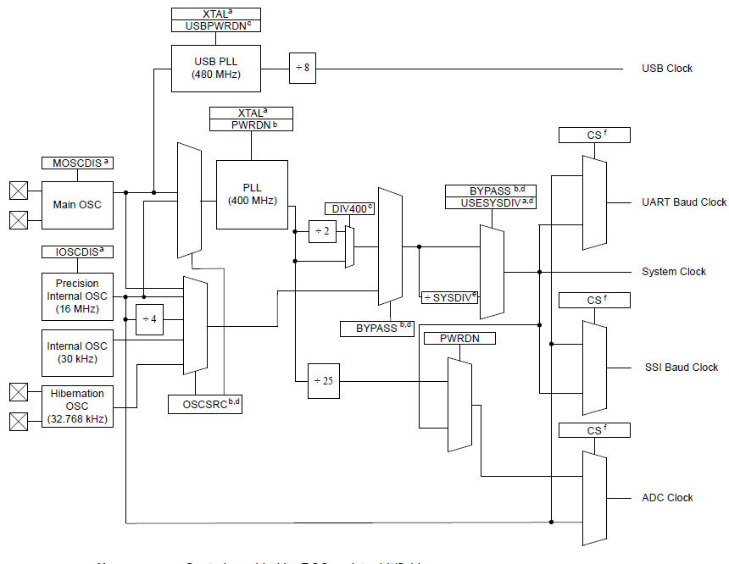
Tiva C Series Clock Tree
driverLib API SysCtlClockSet() selects:
SYSDIV divider setting
OSC or PLL
Main or Internal oscillator
Crystal frequency
GPIO...
Notes:
This is the Tiva C Series clock tree. Its flexible implementation provides you with the different types of clocks that you need for low-power operation, for low-cost operation and for high-precision operation. On the previous slide we looked at the possible sources for the System Clock. If you find the System Clock line on the right of this diagram and follow it back through the multiplexors you’ll find that any of the four fundamental clock sources can drive the System Clock.
As an example, let’s connect a 16MHz crystal to the inputs of the main oscillator there on the left. You should bear in mind that there are restrictions on the crystal frequency. Working our way to the right, let’s also use the PLL and divide it properly to drive the System Clock at 80MHz or below.
Making all those selections is simplified with the use of the TiveWare API shown at the bottom of the slide. A single line of code can make all of the choices shown to program the System Clock selections.

Slide 36
General Purpose IO
Any GPIO can be an interrupt:
Edge-triggered on rising, falling or both
Level-sensitive on high or low values
Can directly initiate an ADC sample sequence or µDMA transfer
Toggle rate up to the CPU clock speed on the Advanced High-Performance Bus. ½ CPU clock speed on the Standard.
5V tolerant in input configuration
Programmable Drive Strength (2, 4, 8mA or 8mA with slew rate control)
Programmable weak pull-up, pull-down, and open drain
Pin state can be retained during Hibernation mode
Pin Mux Utility...
Notes:
Tiva C Series general-purpose IO is extremely flexible. Any GPIO can be an interrupt; edge-triggered on rising, falling, or both. It can be level-sensitive to high or low values. Any GPIO can directly initiate an ADC sample sequence or a DMA transfer. The toggle rate can be as high as the CPU clock speed on the advanced high-performance bus. As inputs, all of the GPIO are 5V tolerant.
As outputs, the drive strength is programmable to be 2, 4 or 8mA. The 8mA setting also allows you to configure the slew rate.
The GPIO pins have programmable weak pull-up, pull-down, and open-drain modes.
The pin states can be retained during hibernation mode to correctly connect to external circuitry even while the device sleeps.

Slide 37
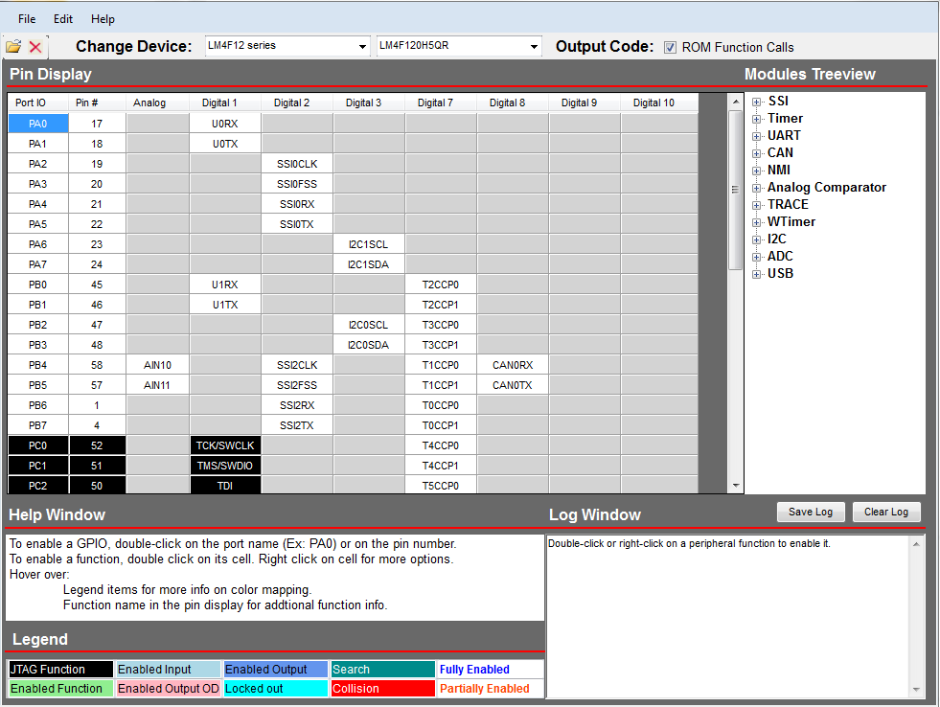
Pin Mux Utility
Allows the user to graphically configure the device pin-out
Generates source and header files for use with any of the supported IDE’s
http://www.ti.com/tool/tm4c_pinmux
Masking...
Notes:
The Pin Mux Utility is a graphical interface that allows the user to easily configure the GPIO. Since the pins on Tiva C Series devices are heavily multiplexed, this configuration can be somewhat difficult. The utility generates human readable source and header files that can be included in your project regardless of the IDE that you are using.

Slide 38
GPIO Address Masking
Each GPIO port has a base address. You can write an 8-bit value directly to this base address and all eight pins are modified. If you want to modify specific bits, you can use a bit-mask to indicate which bits are to be modified. This is done in hardware by mapping each GPIO port to 256 addresses. Bits 9:2 of the address bus are used as the bit mask.
GPIO Port D (0x4005.8000)
The register we want to change is GPIO Port D (0x4005.8000) Current contents of the register is:
0
0
0
1
1
1
0
1
The value we will write is 0xEB:
Write Value (0xEB)
1
1
1
0
1
0
1
1
Instead of writing to GPIO Port D directly, write to 0x4005.8098. Bits 9:2 (shown here) become a bit-mask for the value you write.
…
0
0
0
0
0
1
0
0
1
1
0
0
0
Only the bits marked as “1” in the bit-mask are changed.
0
0
1
1
1
0
1
1
New value in GPIO Port D (note that only the red bits were written)
GPIOPinWrite(GPIO_PORTD_BASE, GPIO_PIN_5|GPIO_PIN_2|GPIO_PIN_1, 0xEB);
Note: you specify base address, bit mask, and value to write. The GIPOPinWrite() function determines the correct address for the mask.
GPIOLOCK ...
Notes:
GPIO address masking is a somewhat unusual technique for programming the GPIO port pins. Each GPIO port has a base address, and if you look in the diagram, GPIO port D has a base address of 40058000. You can write an 8-bit value to the port directly to that base address, and all eight pins will be modified, just like has been done to GPIO ports since the earliest microcontrollers.
If you want to modify specific bits of that port, you would have to read the value on the port pins, change the specific bits, and then write the value back out to the port. This is a read-modify-write operation fraught with issues. For instance, if an interrupt changed a pin state during this process, your code would write the wrong value to the pin.
On the Tiva C Series parts, each port has 256 possible addresses covering every possible combination of the port pins. The GPIOPinWrite() API uses the pin-mash and the base address to form the address that allows us to write to the specified pins. In this case, pins 1, 2 and 5. We can then write or read from those pins only. You should appreciate that this is not a software masking trick, this technique is completely in the hardware.

Slide 39
Critical Function GPIO Protection
Six pins on the device are protected against accidental programming:
PC3,2,1 & 0: JTAG/SWD
PD7 & PF0: NMI
Any write to the following registers for these pins will not be stored unless the GPIOLOCK register has been unlocked:
GPIO Alternate Function Select register
GPIO Pull Up or Pull Down select registers
GPIO Digital Enable register
The following sequence will unlock the GPIOLOCK register for PF0 using direct register programming:
HWREG(GPIO_PORTF_BASE + GPIO_O_LOCK) = GPIO_LOCK_KEY;
HWREG(GPIO_PORTF_BASE + GPIO_O_CR) |= 0x01;
HWREG(GPIO_PORTF_BASE + GPIO_O_LOCK) = 0;
Reading the GPIOLOCK register returns it to lock status
Lab...
Notes:
Six of the pins on the TM4C123GH6PM have critical functions that are protected from accidental disruption. These are the four emulation pins and the two pins dedicated to the non maskable interrupt.
Any write to the alternate function select, pull-up, pull-down or digital enable registers for these pins will not be stored unless the GPIOLOCK register has been unlocked.
The coding sequence shown uses direct register writes to unlock the GPIOLOCK feature of Port F pin 0. Any read of the GPIOLOCK register will return it to locked status.

Slide 40
Lab 3: Initialization and GPIO
USB Emulation Connection
Configure the system clock
Enable and configure GPIO
Use a software delay to toggle an LED on the evaluation board
Agenda ...
Notes:
Lab three is your first chance to write some real code from a blank page. If you don't understand what a TivaWare API function call does or what a parameter means, pause the video and look it up in the user guides. We've provided plenty of explanation in the lab steps, but make sure that you take the time to comprehend what's going on, rather than skipping to the solution. Your hard work will be rewarded.

Slide 41
Agenda
Introduction to ARM® Cortex™-M4F and Peripherals
Code Composer Studio
Introduction to TivaWare™, Initialization and GPIO
Interrupts and the Timers
ADC12
Hibernation Module
USB
Memory and Security
Floating-Point
BoosterPacks and grLib
Synchronous Serial Interface
UART
µDMA
Sensor Hub
PWM
NVIC...
Notes:
In chapter four of the workshop you'll become familiar with interrupts and the timers. You'll use the timer to generate interrupts to the main routine. If you're not already familiar with the concept of microcontroller interrupts and interrupt service routines, now would be a good time to look up that topic online.

Slide 42
Nested Vectored Interrupt Controller (NVIC)
Handles exceptions and interrupts
8 programmable priority levels, priority grouping
7 exceptions and 71 Interrupts
Automatic state saving and restoring
Automatic reading of the vector table entry
Pre-emptive/Nested Interrupts
Tail-chaining
Deterministic: always 12 cycles or 6 with tail-chaining
Motor control ISRs (e.g. PWM, ADC)
Communication ISRs (e.g. CAN)
Main application (foreground)
t
Tail Chaining...
Notes:
The Tiva C Series Nested Vectored Interrupt Controller, or NVIC, is tightly coupled to the central processing unit. It handles all of the exceptions and interrupts that come into the CPU. There are eight programmable priority levels and priority grouping. In most microcontroller interrupt vector tables, the priority levels for each peripheral are set by the manufacturer, and you have no input into what they are. That's not the case on this device. You can reprogram the priorities as you like.
This device has 7 system level exceptions and 65 peripheral interrupts. It has automatic state save and restore for entering and exiting Interrupt Service Routines, as well as automatic reading of the vector table entry to quickly facilitate this process.
One of the first rules that you learn when programming interrupts on a microcontroller is to not nest interrupts, but sometimes you need to nest the interrupts. For instance, you need to get to a very low latency motor control or device. You need to get to it very quickly, and you have other interrupts that take too long. Those long ISRs will need to be interruptible. On most microcontrollers you will have to program this tedious process in software.
On the Tiva C Series devices, you can do it by programming the NVIC hardware. You can make interrupts preemptive, and you can nest them. Interrupts can also be tail-chained, which is something I'll explain in the next few slides. Interrupts are deterministic. They're always either 12 cycles or 6 cycles if they're tail-chained.
Taking a look at the diagram at the bottom, we can see this is an application with a two interrupts. From left to the right, the first interrupt that goes off is for motor control. Motor control requires extremely low latency. You can't wait. You must act on the interrupt quickly.
The second interrupt is a repeat of the first.
In the third instance, a communication interrupt like the CAN has started operation. Communication interrupts using involve FIFO’s and buffers, so they can wait. When the motor control interrupt arrives, we can't wait for the communications ISR to complete, the motor control ISR must preempt it.
The remaining instances are further examples. Remember that the nesting behavior is programmed into the NVIC hardware.

Slide 43
Interrupt Latency - Tail Chaining
Highest Priority
IRQ1
IRQ2
Typical processor
PUSH
ISR 1
POP
PUSH
ISR 2
POP
Tail-chaining
Cortex-M4
Interrupt handling in HW
PUSH
ISR 1
ISR 2
POP
12 Cycles
6 Cycles
12 Cycles
Pre-emption …
Notes:
Tail-chaining reduces interrupt latency. In this diagram, two interrupts go off at the same time: IRQ1, which is the higher priority, and IRQ2. In a typical processor, the state of the processor would be pushed ontot the stack, the highest priority interrupt service routine would run, the state of the processor would be popped off the stack. At this point the interrupt controller would detect that there was another interrupt pending, and repeat the process for the lower priority interrupt.
Note that the pop and the push right in the middle are doing the exact same thing but in opposite directions … there's really no need to do those. Cortex M4 interrupt handling is done in hardware. We have a very short push at the beginning, and then we see that ISR1 runs. The NVIC detects that another interrupt is pending … it simply transfers execution to the pending interrupt's ISR. This process takes 6 cycles. When the second ISR completes and no other interrupts are pending, the state of the processor is restored.
This will result a significant decrease in interrupt latency in the typical interrupt driven system.

Slide 44
Interrupt Latency – Pre-emption
Highest Priority
IRQ1
IRQ2
Typical processor
ISR 1
POP
PUSH
ISR 2
POP
Cortex-M4
ISR 1
POP
ISR 2
POP
1-
12 Cycles
6 Cycles
12 Cycles
Late arrival...
Notes:
The next NVIC operation we’ll look at is called pre-emption. The NVIC allows pre-emption of the pop or push process.
In the diagram we can see that a second interrupt was detected while the interrupt controller was restoring the processor state from the first.
The typical processor is unable to do anything about the situation. It continues its pop process. It then pushes the state of the processor for the second interrupt, resulting in many CPU cycles being wasted.
On the Cortex M4 NVIC, the second interrupt will pre-empt the pop process and trigger a tail-chaining event, again decreasing interrupt latency.

Slide 45
Interrupt Latency – Late Arrival
Highest Priority
IRQ1
IRQ2
Typical processor
PUSH
PUSH
ISR 1
POP
PUSH
ISR 2
POP
Cortex-M4
PUSH
ISR 1
ISR 2
POP
6 Cycles
12 Cycles
Interrupt handling...
Notes:
The next NVIC issue to look at is late arrival. In this case, the lower priority interrupt, IRQ2, goes off just before the higher priority interrupt.
In a typical processor, it would be pushing the status of the processor for IRQ2. As soon as it detected that there was a higher priority interrupt, it would finish the push, start a second push, and then go through the entire normal sequence. The cycles required to perform the extra push operation are completely wasted.
In the Cortex-M4, the NVIC will detect that a higher priority interrupt has occurred. It will simply transfer execution to ISR1 instead of ISR2 and run ISR1. At the end of the interrupt service routine, it will then tail-chain into ISR2. Again, a significant savings in terms of interrupt latency.

Slide 46
Cortex-M4® Interrupt Handling
Interrupt handling is automatic. No instruction overhead.
Entry
Automatically pushes registers R0–R3, R12, LR, PSR, and PC onto the stack
In parallel, ISR is pre-fetched on the instruction bus. ISR ready to start executing as soon as stack PUSH complete
Exit
Processor state is automatically restored from the stack
In parallel, interrupted instruction is pre-fetched ready for execution upon completion of stack POP
Exception types...
Notes:
Cortex M4 interrupt handling is totally automatic, s there's no instruction overhead. On entry the device automatically pushes registers R0 through R3, R2, the LR, the PSR, and the program counter onto the stack. In parallel, the address of the applicable interrupt service routine is pre-fetched onto the instruction bus. The ISR is then ready to start executing as soon as the last stack push is complete.
On the exit side, the processor state is automatically restored from the stack. In parallel, the address of the interrupted instruction is pre-fetched, ready for execution upon completion of the final stack pop.

Slide 47
Cortex-M4® Exception Types
Vector Number | Exception Type | Priority | Vector address | Descriptions
1 | Reset | -3 | 0x04 | Reset
2 | NMI | -2 | 0x08 | Non-Maskable Interrupt
3 | Hard Fault | -1 | 0x0C | Error during exception processing
4 | Memory Management Fault | Programmable | 0x10 | MPU violation
5 | Bus Fault | Programmable | 0x14 | Bus error (Prefetch or data abort)
6 | Usage Fault | Programmable | 0x18 | Exceptions due to program errors
7-10 | Reserved | - | 0x1C - 0x28
11 | SVCall | Programmable | 0x2C | SVC instruction
12 | Debug Monitor | Programmable | 0x30 | Exception for debug
13 | Reserved | - | 0x34
14 | PendSV | Programmable | 0x38
15 | SysTick | Programmable | 0x3C | System Tick Timer
16 and above | Interrupts | Programmable | 0x40 | External interrupts (Peripherals)
Vector Table...
Notes:
Exception types on the Cortex M4 include reset, the non-maskable interrupt, hard fault and the 7 shown in the table. Note the priority levels for the rest, NMI and hard faults. Only those cannot be changed.
A HardFault is all classes of fault, when the corresponding fault handler cannot be activated because it is currently disabled or masked by exception masking
A Memory management fault is caused by a Memory Protection Unit violation or invalid accesses (such as an instruction fetch from a non-executable region)
Bus faults are an Error response received from the bus system; caused by an instruction prefetch abort or data access error
Usage faults are caused by invalid instructions or invalid state transition attempts
SVCall is a System service call via SVC instruction
Not that the priority is programmable for most of these faults.

Slide 48
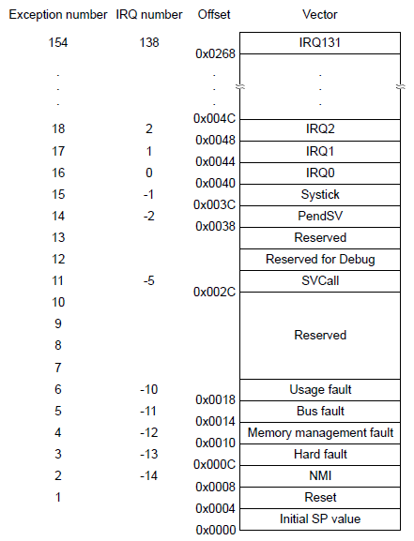
Cortex-M4® Vector Table
After reset, vector table is located at address 0
Each entry contains the address of the function to be executed
The value in address 0x00 is used as starting address of the Main Stack Pointer (MSP)
Vector table can be relocated by writing to the VTABLE register (must be aligned on a 1KB boundary)
Open startup_ccs.c to see vector table coding
GPTM...
Notes:
After reset, Cortex M4 vector table is located at address zero. Each entry in the vector table contains the address of the handler or ISR to be executed.
If you look down at the bottom at the initial SP value, that value at address 00 is used as a starting address of the main stack pointer.
It’s typical to relocate the vector table after bootloading the device and this can be done by writing to the VTABLE register. The vector table must be aligned on a 1K byte boundary. If you like, open up startup_ccs.c in Code Composer for a complete view of the vector table.

Slide 49

General Purpose Timer Module
Six 16/32-bit and Six 32/64-bit general purpose timers
Twelve 16/32-bit and Twelve 32/64-bit capture/compare/PWM pins
Timer modes:
One-shot
Periodic
Input edge count or time capture with 16-bit prescaler
PWM generation (separated only)
Real-Time Clock (concatenated only)
Count up or down
Simple PWM (no deadband generation)
Support for timer synchronization, daisy-chains, and stalling during debugging
May trigger ADC samples or DMA transfers
Lab...
Notes:
The General Purpose Timer Module, or GPTM, has six 16 or 32-bit and six 32 or 64-bit general-purpose timers. They can be used for capture, compare, or PWM. There are 5 different time modes available: one shot, periodic, input edge count or time capture, PWM generation and Real time clock.
The timers can count up or down.
PWM generation is simple with no deadband generation and software inversion of the outputs.
The module supports synchronization across multiple timers, daisy chaining and user enabled stalling during debugging. This last feature stalls the timers during debug when the user clicks the halt button and prevents unwanted timer interrupts from occurring.
The timers can also trigger the ADC sample sequencer or DMA transfers.

Slide 50
Lab 4: Interrupts and the GP Timer
USB Emulation Connection
Enable and configure the Timer
Enable and configure Interrupts
Write the ISR code and test
Generate an exception
Agenda ...
Notes:
In lab four, we'll use the general-purpose timer to count down from a preset value. When the timer reaches zero, an interrupt will be generated and the timer will be reloaded. The NVIC on the Tiva C Series device will then find the correct address of the interrupt service routine you've written and execute it. These are all real-world skills that you'll need over and over again when working with any microcontroller.

Slide 51
Agenda
Introduction to ARM® Cortex™-M4F and Peripherals
Code Composer Studio
Introduction to TivaWare™, Initialization and GPIO
Interrupts and the Timers
ADC12
Hibernation Module
USB
Memory and Security
Floating-Point
BoosterPacks and grLib
Synchronous Serial Interface
UART
µDMA
Sensor Hub
PWM
ADC...
Notes:
Chapter 5 covers the 12-bit, analog-to-digital converter or ADC12. The TM4C123GH6PM has two of these ADCs. One channel of the ADC12 is connected to an internal temperature sensor. You'll use that sensor in the lab to monitor the temperature of the microcontroller and experiment with the ADC12.

Slide 52
Analog-to-Digital Converter
Tiva TM4C MCUs feature two ADC modules (ADC0 and ADC1) that can be used to convert continuous analog voltages to discrete digital values
Each ADC module has 12-bit resolution
Each ADC module operates independently and can:
Execute different sample sequences
Sample any of the shared analog input channels
Generate interrupts & triggers
ADC
V_{IN}
V_{OUT}
V_{IN}
t
12
101
Input Channels
Interrupts/ Triggers
100
ADC0
V_{OUT}
011
010
ADC1
Interrupts/ Triggers
001
Triggers
000
t
Features...
Notes:
Tiva C Series microcontrollers feature two ADC modules, ADC0 and ADC1, that can be used to convert continuous analog voltages to discrete digital values. Each one of those modules has 12 bits of resolution, can operate independently and can execute different sample sequences. You can sample any of the shared analog input channels, single ended or differential and you can generate interrupts and triggers.

Slide 53
TM4C123GH6PM ADC Features
Two 12-bit 1MSPS ADCs
12 shared analog input channels
Single ended & differential input configurations
On-chip temperature sensor
Maximum sample rate of one million samples/second (1MSPS).
Fixed references (VDDA/GNDA) due to pin-count limitations
4 programmable sample conversion sequencers per ADC
Separate analog power & ground pins
Flexible trigger control
Controller/ software
Timers
Analog comparators
GPIO
2x to 64x hardware averaging
8 Digital comparators / per ADC
2 Analog comparators
Optional phase shift in sample time, between ADC modules … programmable from 22.5 ° to 337.5°
ADC
V_{IN}
V_{OUT}
Sequencers...
Notes:
Due to the low pin count of the LaunchPad device, there is a fixed reference between the analog voltage and ground and 12 shared I/O.
There are four programmable sample conversion sequencers per ADC that we'll deal with on the next slide. Separate analog power and ground pins keep the noise between the digital and analog sides low.
There are 5 ways to trigger a measurement … with software, when a timer expires, on an analog comparison event or using a GPIO pin.
Hardware averaging can take 2, 4, 8, 16, 32 or 64 samples and average them together to generate each result..
Each ADC has eight digital comparators for a total of 16. There are two analog comparators for the device. Optionally, you can phase shift the sample time between the ADC modules, between 22.5 to 337.5 degrees.

Slide 54
ADC Sample Sequencers
Tiva TM4C ADC’s collect and sample data using programmable sequencers.
Each sample sequence is a fully programmable series of consecutive (back-to-back) samples that allows the ADC module to collect data from multiple input sources without having to be re-configured.
Each ADC module has 4 sample sequencers that control sampling and data capture.
All sample sequencers are identical except for the number of samples they can capture and the depth of their FIFO.
To configure a sample sequencer, the following information is required:
Input source for each sample
Mode (single-ended, or differential) for each sample
Interrupt generation on sample completion for each sample
Indicator for the last sample in the sequence
Each sample sequencer can transfer data independently through a dedicated μDMA channel.
Sequencer | Number of Samples | Depth of FIFO
SS 3 | 1 | 1
SS 2 | 4 | 4
SS 1 | 4 | 4
SS 0 | 8 | 8
Lab...
Notes:
The analog to digital converters collect and sample their data using programmable sequencers. Each sample sequence is a fully programmable series of consecutive samples that allows the ADC to collect data from multiple input sources without having to be reconfigured. Each one of the modules has four sample sequencers that control the sampling and data capture. They are identical except for the number of samples that they can capture and the depth of the associated FIFO.
In order to configure a sample sequence, the following information is required for each sample: the input source, whether the mode is single ended or differential, whether or not to generate an interrupt and whether this is the final sample in the sequence.
Each sample sequencer can then transfer its data from the FIFO independently using a dedicated DMA channel.

Slide 55
Lab 5: ADC12
USB Emulation Connection
Enable and configure ADC and sequencer
Measure and display values from internal temperature sensor
Add hardware averaging
Use ROM peripheral driver library calls and note size difference
Agenda ...
Notes:
In lab five, you'll write code to make measurements using the on-chip, 12-bit, analog-to-digital converter. To keep things simple, you'll use the internal temperature sensor as an input. You can then use your finger to warm the microcontroller on the LaunchPad board to see the temperature change.

Slide 56
Agenda
Introduction to ARM® Cortex™-M4F and Peripherals
Code Composer Studio
Introduction to TivaWare™, Initialization and GPIO
Interrupts and the Timers
ADC12
Hibernation Module
USB
Memory and Security
Floating-Point
BoosterPacks and grLib
Synchronous Serial Interface
UART
µDMA
Sensor Hub
PWM
Key Features...
Notes:
Chapter six covers the hibernation module and low-power modes. This module manages the removal and restoration of power to the CPU and peripherals to provide a means of reducing power consumption. Additional features include a real-time clock that can be used for wake events and battery-backed SRAM for storing and restoring the processor state.

Slide 57
Key Features
Real Time Clock is a 32-bit seconds counter with a 15-bit sub seconds counter & add-in trim capability
Dedicated pin for waking using an external signal
RTC operational and hibernation memory valid as long as V_{BAT} is valid
GPIO pins state retention provided during VDD3ON mode
Two mechanisms for power control
System Power Control for CPU and other on-board hardware
On-chip Power Control for CPU only
Low-battery detection, signaling, and interrupt generation, with optional wake on low battery
32,768 Hz external crystal or an external oscillator clock source
16 32-bit words of battery-backed memory are provided for you to save the processor state to during hibernation
Programmable interrupts for RTC match, external wake, and low battery events.
Low Power Modes...
Notes:
The real-time clock is a 32-bit seconds counter with a 15-bit sub-seconds counter. It has add-in trim capability for precision control over the time. A clock crystal or external oscillator can drive the hibernation module’s real-time clock. As long as the battery voltage is valid, the clock will be operational, and the hibernation memory will be valid. There is a dedicated external pin for waking up using an external signal and the part can wake from a real-time clock match.
On the LaunchPad board, the battery voltage is connected directly to the processor voltage. In this configuration, the battery voltage will never be invalid. But in your design, you will likely have a separate battery. If that battery is dead or is not present, you don't want your part going into hibernation mode. The design of the module will not allow the part to hibernate if that battery voltage is not valid.
There is also a VDD3ON mode that provides state retention of the GPIO pins during hibernation. Since hibernation actually powers down the device, the pins may still be connected to powered circuitry in your design. Keeping the pin states fixed will prevent errors or damage to that circuitry.
There are two methods to control power: there is an on-chip voltage regulator for power control for the CPU only and an external pin to control system power. By connecting this pin to an external voltage regulator you can control power to any external circuitry that you choose.
The hibernation module has low battery detection, signaling, and interrupt generation with optional wake on low battery. If the backup battery voltage drops to the point where it can’t maintain the battery backed SRAM, you probably want to wake up.
The battery-backed SRAM memory has sixteen 32-bit words for saving the processor state. SRAM is extremely fast and power efficient. Some designs incorporate power failure detection and save the processor state before power fails completely. This requires some capacitance on the board to store enough energy for this operation. Other types of memory like flash or EEPROM require significantly more energy and can actually be physically damaged if a write is in process when power is removed.

Slide 58
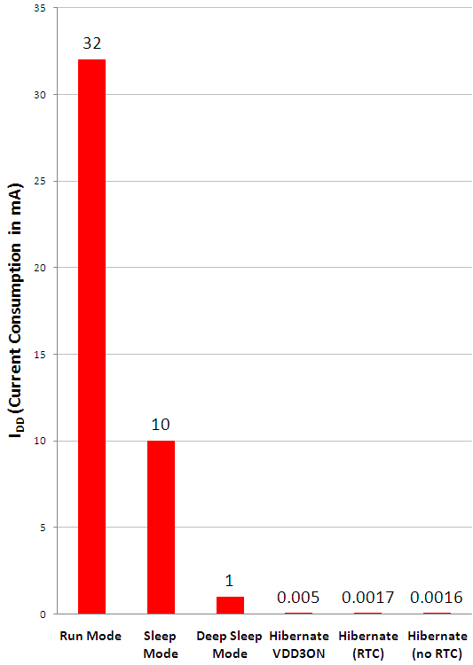
Power Modes
Run mode
Sleep mode stops the processor clock
2 SysClk wakeup time
Deep Sleep mode stops the system clock and switches off the PLL and Flash
1.25 – 350 µS wakeup time
Hibernate mode with only hibernate module powered (VDD3ON, RTC and no RTC)
~500µS wakeup time
TBD
1.05
Power Mode Comparison...
Notes:
Power modes on the Tiva C Series parts are run, sleep, deep sleep, and then several types of hibernate.
The current consumption measurements shown were made at 40 MHz with the PLL on for the run and sleep modes. As the part is placed in progressively deeper sleep modes, more and more of the part is turned off.
In sleep mode the processor clock is stopped, which turns off the CPU. Wake up time is a very fast two clock cycles.
In deep sleep mode the system clock, the PLL and the flash memory are also turned off. Wake-up time in this mode is 1.25 to 350 microseconds.
In hibernate modes, only the hibernate module is powered. You have the option to retain the state of the pins with the VDD3ON mode. You can also enabled or disabled the real-time-clock. Wake-up time in hibernate modes is around 500 microseconds.

Slide 59
Power Mode Comparison
Mode → | Run Mode | Sleep Mode | Deep Sleep Mode | Hibernation (VDD3ON) | Hibernation (RTC) | Hibernation (no RTC)
Parameter ↓
I_{DD} | 32 mA | 10 mA | 1.05 mA | 5 μA | 1.7 μA | 1.6 μA
V_{DD} | 3.3 V | 3.3 V | 3.3 V | 3.3 V | 0 V | 0 V
V_{BAT} | N.A. | N.A. | N.A. | 3 V | 3 V | 3 V
System Clock | 40 MHz with PLL | 40 MHz with PLL | 30 kHz | Off | Off | Off
Core | Powered On | Powered On | Powered On | Off | Off | Off
 | Clocked | Not Clocked | Not Clocked | Not Clocked | Not Clocked | Not Clocked
Peripherals | All On | All Off | All Off | All Off | All Off | All Off
Code | while{1} | N.A. | N.A. | N.A. | N.A. | N.A.
Box denotes power modes available on LaunchPad board
LaunchPad Considerations ...
Notes:
This power mode comparison provides further details for each of the modes. Fixed conditions are that the part is running at 3.3 volts, the run mode speed is 40 MHz using the PLL.
Note that dotted red box around some of the measurements. Because Vdd and Vbat are connected together on the launchpad, the two columns on the furthest right are not available.
Note that different clocking of the part for each of the modes. As clocks are removed, the peripherals will be unavailable to provide a wake up interrupt. In the hibernation modes where the core, peripherals and system clock are all turned off, only the hibernation module is available to wake the part. At this point the only wake events available are the wake-up pin and the Real-Time clock match.

Slide 60
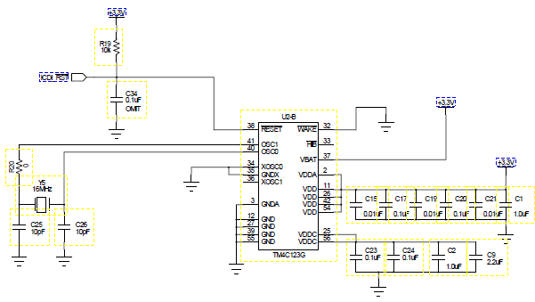
LaunchPad Considerations
The low-cost LaunchPad board does not have a battery holder
VDD and VBAT are wired together on the board (this disables battery-only powered low-power modes)
Device current is measured between test points H24 and H25
Lab ...
Notes:
The low-cost LaunchPad board does not have a battery holder. VDD and the Vbat are wired together on the board. So that disables the battery-only powered hibernation modes.
Take a look at your LaunchPad board. Near the top you'll see a jumper. R30 has been omitted from the board and the jumper on pins H24 and H25 connect across its location. We will be able to use our meter to measure the current between those two pins.
Most Digital Multimeters have an issue with equivalent series resistance. If you have the DMM set to measure a very low current, this resistance may not permit a higher current to flow when needed. You will have to switch the mode on the meter.

Slide 61
Lab 6: Low Power Modes
USB Emulation Connection
Power Measurement Jumper
Place device in low power modes
Wake from pin
Wake from RTC
Measure current
No battery holder on board
Agenda ...
Notes:
In lab six, you're going to measure the current draw of the TM4C device when it's placed in run and hibernate modes. The low-cost Tiva launchpad board does not have a battery holder, so the battery power input is connected to the power for the CPU. This will shorten our experiment somewhat, but you'll still see the device wake up from the Real-Time clock and wake pin events.

Slide 62
Agenda
Introduction to ARM® Cortex™-M4F and Peripherals
Code Composer Studio
Introduction to TivaWare™, Initialization and GPIO
Interrupts and the Timers
ADC12
Hibernation Module
USB
Memory and Security
Floating-Point
BoosterPacks and grLib
Synchronous Serial Interface
UART
µDMA
Sensor Hub
PWM
USB Basics...
Notes:
The TM4C123GH6PM is equipped with a 12 megabit per second, USB 2.0 compliant, USB port. This USB port is capable of on the go, host and device modes. In chapter six, you'll look at the basics of USB and how the USB port is implemented.
Since we don't have an adapter cable, we'll limit ourselves to experimenting with the USB Port as a device.

Slide 63
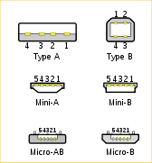
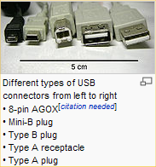
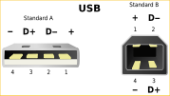
USB Basics
Multiple connector sizes
4 pins – power, ground and 2 data lines (5th pin ID for USB 2.0 connectors)
Configuration connects power 1st, then data
Standards:
USB 1.1
Defines Host (master) and Device (slave)
Speeds to 12Mbits/sec
Devices can consume 500mA (100mA for startup)
USB 2.0
Speeds to 480Mbits/sec
OTG addendum
USB 3.0
Speeds to 4.8Gbits/sec
New connector(s)
Separate transmit/receive data lines
USB Basics...
Notes:
USB connectors come in multiple sizes and most have four pins: Power, ground, and two data lines called D+ and D-. Some connectors have a fifth pin for USB 2.0 ID.
In the diagram on the bottom right, note that the pins for the power are slightly longer than the data pins. In this way, the power will be connected before data.
The USB 1.1 standard defines the host as the master and the device as the slave, and speeds of up to 12 megabits per second . Devices can consume 500 milliamps once they're enumerated, but only 100 milliamps at startup.
USB 2.0 supports speeds as high as 480 megabits per second, but a full speed 12 megabits per second port like the one on the Tiva C Series devices, is still compliant. USB 2.0 also includes the on-the-go addendum where devices negotiate for host or device status.
USB 3.0 supports speeds to 4.8 gigabits per second. New connectors separate the transmit and receive data lines to support these speeds.

Slide 64
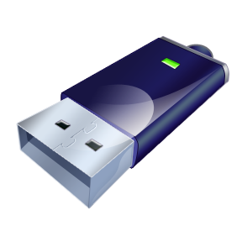
USB Basics
USB Device … most USB products are slaves
USB Host … usually a PC, but can be embedded
USB OTG … On-The-Go
Dynamic switching between host and device roles
Two connected OTG ports undergo host negotiation
Host polls each Device at power up. Information from Device includes:
Device Descriptor (Manufacturer & Product ID so Host can find driver)
Configuration Descriptor (Power consumption and Interface descriptors)
Endpoint Descriptors (Transfer type, speed, etc)
Process is called Enumeration … allows Plug-and-Play
TM4C123GH6PM USB...
Notes:
Most USB products sold are slaves ... for instance, a USB flash drive or camera.
USB hosts are normally a PC or other computing device, but the host function can be embedded into smaller designs. USB on the go is dynamic switching between the host and device roles. When two on-the-go ports are connected together, they undergo a negotiation to determine which will act as the host and which the device.
For instance, if you connected a digital camera to your PC, you'd certainly want the camera to be a slave to the PC's host. But if you took that same camera and connected it to a printer, you’d want the camera to be a host to the printer's slave so that you could print to it.
When a device is connected to a host, the host polls the device for information that describes it called descriptor tables. The device descriptor contains the manufacturer and product ID code. The configuration descriptor contains the power consumption and interface types required. The endpoint descriptor describes the transfer types, speed and so one for each of the endpoints required of the port. The process of the host querying the device for all of these structures and then configuring itself is called enumeration, and that's what allows plug-and-play to operate.

Slide 65

TM4C123GH6PM USB
USB 2.0 full speed (12 Mbps) and low speed (1.5 Mbps) operation
On-the-go (OTG), Host and Device functions
Integrated PHY
Transfer types: Control, Interrupt, Bulk and Isochronous
Device Firmware Update (DFU) device in ROM
Tiva collaterals
Texas Instruments is a member of the USB Implementers Forum.
Tiva is approved to use the USB logo
Vendor/Product ID sharing
http://www.ti.com/lit/pdf/spml001
FREE
Vendor ID/ Product ID
sharing program
Block Diagram...
Notes:
65
The USB port on the TM4C123GH6PM is USB 2.0 compliant at 12 megabits per second full speed operation. It can also operate in low speed mode which is 1.5 megabits per second. The device has an integrated PHY, or physical interface , so that the hardware connection to the USB port is very simple. All the normal transfer types are supported : control, interrupt, bulk, and isochronous.
The port also supports DFU, or device firmware update in ROM, for both host and device operation. This means the device can be plugged into a host and the DFU can accept update files . It also means that the device can act as a host and download update files from a properly formatted device , like the flash drive .
TI is a member of the USB implementers' forum, and Tiva is approved for use of the USB logo. The stacks, the hardware and so on are certified USB compliant.
We also offer vendor and product I.D. sharing so that you do not have to purchase the codes . You simply sub-license ours.

Slide 66
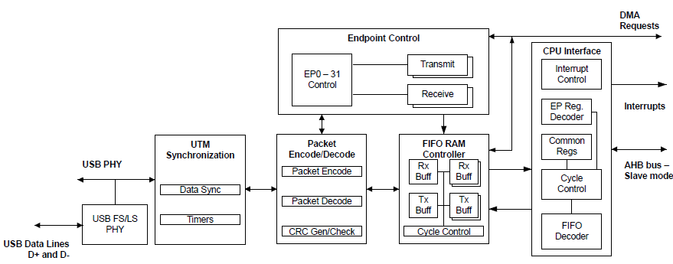
USB Peripheral Block Diagram
EP0 – 15 Control
Integrated USB Controller and PHY with up to 16 Endpoints
1 dedicated control IN endpoint and 1 dedicated control OUT endpoint
Up to 7 configurable IN endpoints and 7 configurable OUT endpoints
4 KB dedicated endpoint memory (not part of device SRAM)
Separate DMA channels (up to three IN Endpoints and three OUT Endpoints)
1 endpoint may be defined for double-buffered 1023-bytes isochronous packet size
USBLib...
Notes:
The block diagram for the USB peripheral is shown at the top of this slide. This is a integrated USB controller and PHY (or physical interface) that offers up to 16 endpoints. Enumeration requires a dedicated control input and a dedicated control output endpoint. There are up to seven additional configurable input endpoints and seven additional configurable output endpoints.
The controller module has 4K of dedicated endpoint memory which is not part of the device’s SRAM.
DMA is supported on three separate in endpoints and three separate out endpoints .
For bursty data , one endpoint can utilize a 1023 byte double buffered buffer from the 4K memory.

Slide 67

TivaWare™ USBLib
License-free & royalty-free drivers, stack and example applications for Tiva MCUs
USBLib supports Host/Device and OTG
Builds on DriverLib API
Adds framework for generic Host and Device functionality
Includes implementations of common USB classes
Layered structure
Drivers and .inf files included where appropriate
Tiva MCUs have passed USB Device and Embedded Host compliance testing
Device Examples
HID Keyboard
HID Mouse
CDC Serial
Mass Storage
Generic Bulk
Audio
Device Firmware Upgrade
Oscilloscope
Windows INF for supported devices
Points to base Windows drivers
Sets config string
Sets PID/VID
Precompiled DLL saves development time
Device framework integrated into USBLib
Abstraction Levels...
Notes:
TivaWare’s USB library supports host , device and on-the-go operation . It is built on the peripheral driver libraries API set. This construction adds a framework for a generic host and a generic device functionality that you can build on . It includes implementations of common USB classes.
The construction of the framework is layered so that the designer can decide on the amount of abstraction they want to utilize .
Drivers and INF files have been included where needed.
The list on the right shows some of the device examples and supported windows features included in the USB library. There are also a number of host examples , but since the kit does not include the adapter cable, we will leave those to you to investigate.

Slide 68
USB API Abstraction Levels
Application 4
Implements its own USB protocol using Driverlib.
(Third party USB stack)
Application 3
Uses existing API for generic host/device operation.
Uses DriverLib for features not covered by these APIs.
(Custom Classes)
Application 2
Passes key info to the Driver API.
Driver API handles all lower level functions for the chosen class.
(Custom HID device)
Application 1
Passes simplified data to a higher level API.
(Custom HID mouse)
HIGH
Host Class/ Device Class APIs
Host Class Driver/Device Class Driver APIs
Level of abstraction
USB Host Controller API/USB Device API
USB DriverLib API
LOW
LOW
Level of customization
HIGH
Lab...
Notes:
The USB libraries APIs are built on top of the peripheral driver library APIs. You can decide on what level of customization that you want to deal with. Take a look at the far left application 1, here you want to pass simple data to a higher level API. This would be a customization of an existing device , in this case a custom human interface device like a mouse .
As you move to the far right of the chart, your level of customization increases to the point where you might be implementing your own USB protocol , or write or purchase your own USB stack .
Obviously, on the far left of the chart, less time will be spent developing the USB software, while on the far right the developer has much more control.
Where should you start? For an application that involves implementing its own USB protocol using driver lib, working with USB driver API will be a recommended approach. This provides the lowest level of abstraction, giving user most amount of visibility & control. This is represented in Application 4 in the diagram on the slide.
For applications in between, like Example 2 and 3 shown, a user can pick and choose a level of abstraction that is not too low or too high.
Note that devices that resemble existing applications, and many do, require significantly less new code.

Slide 69
Lab 7: USB
USB Emulation Connection
USB Device Connection
Run usb_bulk_example code and windows side app
Inspect stack setup
Observe data on device
Agenda ...
Notes:
In lab 7, you'll use a TivaWare code example to implement bulk transfers of data from your laptop host to and from the USB port on the LaunchPad. You'll use a small Windows side application to send and view data while also watching messages on the terminal display. You'll also use the emulator to view the transferred data in the TM4C123GH6PM memory.

Slide 70
Agenda
Introduction to ARM® Cortex™-M4F and Peripherals
Code Composer Studio
Introduction to TivaWare™, Initialization and GPIO
Interrupts and the Timers
ADC12
Hibernation Module
USB
Memory and Security
Floating-Point
BoosterPacks and grLib
Synchronous Serial Interface
UART
µDMA
Sensor Hub
PWM
Memory Control...
Notes:
The TM4C123GH6PM has four different types of memory: flash, SRAM, EEPROM, and ROM. In chapter 8, you'll learn about the different features and capabilities of these memories. You'll also learn how to use bit banding and how to use the Memory Protection Unit, or MPU.

Slide 71
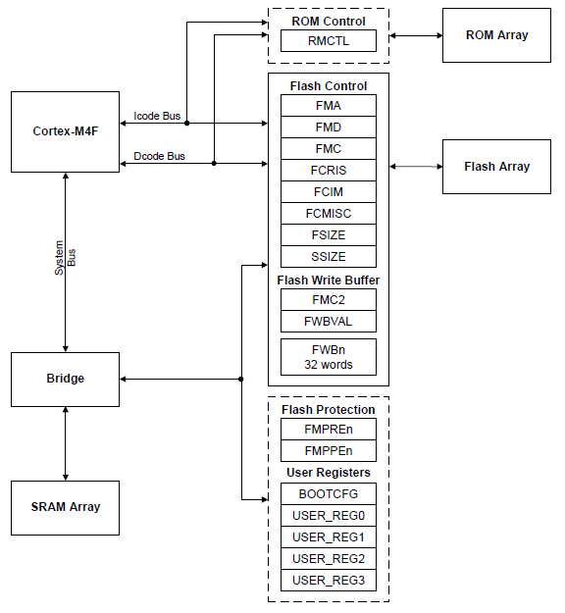
Flash, SRAM and ROM Control
Memory Blocks and Control Logic for:
SRAM
ROM
Flash
EEPROM Control...
Notes:
This diagram shows you the memory controller on the device. Note that there are separate buses for instruction address and data. Connection the to data in flash, the control registers and the SRAM array is done through the separate system bus. This means that the internal architecture is Harvard.

Slide 72
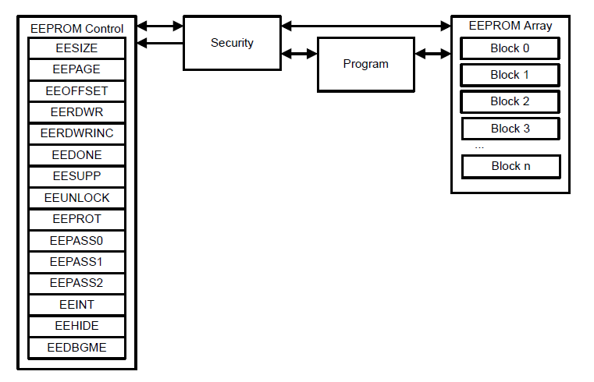
EEPROM Control
EEPROM Block and Control Logic
EEPROM block is connected to the AHB (Advanced High Performance Bus)
Flash Features...
Notes:
EEPROM control is separate from the other memories because it is located in peripheral space. The security block prevents EEPROM memory from being inadvertently written.
EEPROM is connected to the advanced, high-performance bus for maximum speed.

Slide 73

Flash
256KB / 40MHz starting at 0x00000000
Organized in 1KB independently erasable blocks
Code fetches and data access occur over separate buses
Below 40MHz, Flash access is single cycle
Above 40MHz, the prefetch buffer fetches two 32-bit words/cycle. No wait states for sequential code.
Branch speculation avoids wait state on some branches
Programmable write and execution protection available
Simple programming interface
0x00000000 Flash
0x01000000 ROM
0x20000000 SRAM
0x22000000 Bit-banded SRAM
0x40000000 Peripherals & EEPROM
0x42000000 Bit-banded Peripherals
0xE0000000 Instrumentation, ETM, etc.
EEPROM...
Notes:
Below 40 MHz, access to flash memory is single-cycle.
The instruction pre-fetch fetches two 32-bit words per cycle. Since Thumb-2 instructions are a maximum of 32-bits in length, the device can fetch at least two instructions per cycle.
This pre-fetch is important at speeds above 40 MHz. Because of it, in straight line sequential code, no wait states are required, even at 80 MHz.
The issue will be branches. The part has branch speculation, so that on one direction of the branch, it pre-fetch’s the instruction in that direction, avoiding a wait state. Your code will incur a wait state only on one side of branches, allowing 40 MHz flash to operate at near 80 MHz speeds
Write and execution protection are available on the flash so that It can’t be written to without a password. It has a very simple programming interface, as we'll see in the lab.

Slide 74
EEPROM
2KB of memory starting at 0x400AF000 in Peripheral space
Accessible as 512 32-bit words
32 blocks of 16 words (64 bytes) with access protection per block
Built-in wear leveling with endurance of 500K writes
Lock protection option for the whole peripheral as well as per block using 32-bit to 96-bit codes
Interrupt support for write completion to avoid polling
Random and sequential read/write access (4 cycles max/word)
0x00000000 Flash
0x01000000 ROM
0x20000000 SRAM
0x22000000 Bit-banded SRAM
0x40000000 Peripherals & EEPROM
0x42000000 Bit-banded Peripherals
0xE0000000 Instrumentation, ETM, etc.
SRAM...
Notes:
EEPROM memory is 2K in length starting at 0X400AF000. It is accessible as 512 32-bit words, which is broken up into 32 blocks of 16 words. Each block has access protection built in using 32-bit to 96-bit codes. This protection is also available at the module level. The memory has an endurance of 500,000 writes with built-in wear leveling.
When writing to EEPROM from code, write completion can be assured either through polling or in an interrupt .
Random read/write access to EEPROM requires four cycles/word. Sequential writes require the same amount for the first access and then single-cycle for each one afterwards.

Slide 75
SRAM
32KB / 80MHz starting at 0x20000000
Bit banded to 0x22000000
Can hold code or data
0x00000000 Flash
0x01000000 ROM
0x20000000 SRAM
0x22000000 Bit-banded SRAM
0x40000000 Peripherals & EEPROM
0x42000000 Bit-banded Peripherals
0xE0000000 Instrumentation, ETM, etc.
Bit-Banding...
Notes:
SRAM memory is 32 kB starting at 20,000,000 and operates at 80MHz. That physical memory is bit-banded into 22,000,000. SRAM can hold code or data. You can execute code out of SRAM if you choose to do so.

Slide 76
Bit-Banding
Reduces the number of read-modify-write operations
SRAM and Peripheral space use address aliases to access individual bits in a single, atomic operation
SRAM starts at base address 0x20000000 Bit-banded SRAM starts at base address 0x2200000
Peripheral space starts at base address 0x40000000 Bit-banded peripheral space starts at base address 0x42000000
The bit-band alias is calculated by using the formula:
bit-band alias = bit-band base + (byte offset * 0x20) + (bit number * 4)
For example, bit-7 at address 0x20002000 is:
0x20002000 + (0x2000 * 0x20) + (7 * 4) = 0x2204001C
MPU...
Notes:
Tiva C Series devices utilize bit-banding. This can reduce the number of read-modify-write operations done in your code. SRAM and peripheral space use an address alias to access individual bits in a single atomic operation. Physical SRAM memory, starts at a base address of 20,000,000 The bit-banded alias of that memory SRAM starts at base address 22,000,000. Peripheral space starts at a base address of 40,000,000. Bit-banded peripheral space starts at base address 42,000,000.
To calculate the bit-banded alias, use the formula here. The code we’ll be using in the lab does this at run-time.

Slide 77
Memory Protection Unit (MPU)
Defines 8 separate memory regions plus a background region accessible only from privileged mode
Regions of 256 bytes or more are divided into 8 equal-sized sub-regions
MPU definitions for all regions include:
Location
Size
Access permissions
Memory attributes
Accessing a prohibited region causes a memory management fault
Privilege Levels...
Notes:
The memory protection unit defines eight separate memory regions, plus a background region that's accessible only from privileged mode. Regions 256 bytes or larger in size get divided into eight equal sized sub-regions.
MPU configuration can be relatively simple or very complex depending on your goal. You can configure different attributes for each region and sub-region. For example, allow code execution, allow data, allow writes, etc.
Accessing a region in a prohibited way will cause an immediate memory management fault.

Slide 78
Cortex M4 Privilege Levels
Privilege levels offer additional protection for software, particularly operating systems
Unprivileged : software has …
Limited access to the Priority Mask register
No access to the system timer, NVIC, or system control block
Possibly restricted access to memory or peripherals (FPU, MPU, etc)
Privileged: software has …
use of all the instructions and has access to all resources
ISRs operate in privileged mode
Thread code operates in unprivileged mode unless the level is changed via the Thread Mode Privilege Level (TMPL) bit in the CONTROL register
Lab...
Notes:
The Cortex M4 has two different privilege levels; privileged and unprivileged. These levels offer additional protection for software, particularly if you're using operating systems. In unprivileged mode, software has limited access to the priority mask register, no access to the system timer, the NVIC, or the system control block, and possibly restricted access to memory or peripherals. Privileged software has use of all instructions and has access to all the resources.
Interrupt service routines operate in privileged mode. Threaded code, like in an operating system, operates in unprivileged mode unless the level is changed via the thread mode privilege level bit in the control register.

Slide 79
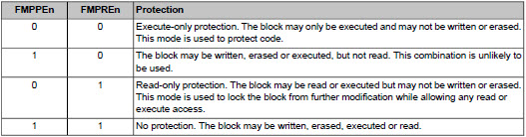
Securing Your IP
Flash memory can be protected (per 2KB memory block). Prohibited access attempts will generate a bus fault.
The JTAG and SWD ports can be disabled. DBG0 = 0 and DBG1 = 1 ( in BOOTCFG register) for debug to be available. The user should be careful to provide a mechanism, for instance via the bootloader of enabling the ports since this is permanent.
There is a set of steps in the UG for recovering a “locked” microcontroller, but this will result in the mass erase of flash memory.
Notes:
Many customers find it important to secure their programming efforts from unwanted snooping or duplication. Each 2K Flash memory block can be configured using the FMPPE and FMPRE register bits to execute-only, read-only or the default unsecure states.
To further protect the device, the debugger ports can be disabled using the DBG bits. Bear in mind that a mechanism should be provided to re-enable these ports since the device will be inaccessible once the ports are disabled.
In case you require access to the device after the ports have been disabled, the user’s guide provides an extensive set of steps to accomplish this. Once done, the device’s flash memory will be mass erased.

Slide 80
Lab 8: Memory and the MPU
USB Emulation Connection
Create code to write to Flash
Create code to read/write EEPROM
Experiment with MPU and bit-banding
Agenda ...
Notes:
In lab 8, you'll create code to write to flash and to rewrite EEPROM. You'll also experiment with bit banding. Then you'll configure and use the memory protection unit.

Slide 81
Agenda
Introduction to ARM® Cortex™-M4F and Peripherals
Code Composer Studio
Introduction to TivaWare™, Initialization and GPIO
Interrupts and the Timers
ADC12
Hibernation Module
USB
Memory and Security
Floating-Point
BoosterPacks and grLib
Synchronous Serial Interface
UART
µDMA
Sensor Hub
PWM
What is Floating-Point?...
Notes:
In chapter 9, you'll learn about the floating point unit on the TM4C123GH6PM. All of TI's Cortex M4 devices are equipped with a floating point unit, though for code compatibility reasons, it is switched off at reset. You'll learn about the basics of floating point numbers and how Tiva C Series devices implement them.

Slide 82
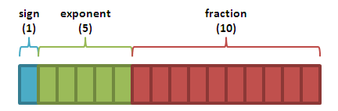
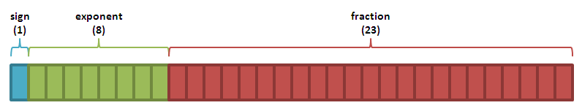
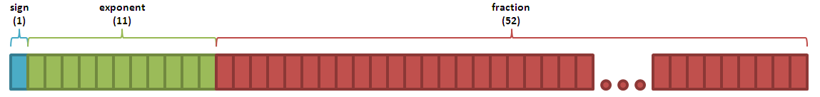
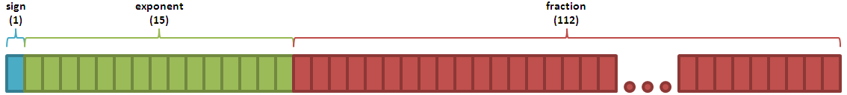
What is Floating-Point?
Floating-point is a way to represent real numbers on computers
IEEE floating-point formats:
Half (16-bit) →
Single (32-bit) →
Double (64-bit) →
Quadruple (128-bit) →
What is IEEE-754?...
Notes:
Floating point is a way to represent real numbers on computers. There are several IEEE floating point formats: half precision at 16 bits, single precision at 32 bits, double precision at 64 bits, and quadruple at 128 bits.
IEEE-754 is single precision and the format use on the Tiva C Series devices.

Slide 83
What is IEEE-754?
Bit |  |  | 31 | 30 | 29 | 28 | 27 | 26 | 25 | 24 | 23 | 22 | 21 | 20 | 19 | 18 | 17 | 16 | 15 | 14 | 13 | 12 | 11 | 10 | 9 | 8 | 7 | 6 | 5 | 4 | 3 | 2 | 1 | 0 | X
Symbol |  |  | Sign (s) | Exponent (e) |  |  |  |  |  |  |  | Fraction (f)
1 bit
8 bits
23 bits
Decimal Value = (-1)^{s} (1+f) 2^{e-bias}
where: f = ∑[(b_{-i})2^{-i}] ∀ i ϵ (1,23)
bias = 127 for single precision floating-point
Symbol |  |  | s | e |  |  |  |  |  |  |  | f
Example |  |  | 0 | 1 | 0 | 0 | 0 | 0 | 1 | 1 | 0 | 1 | 1 | 0 | 1 | 0 | 0 | 0 | 0 | 1 | 0 | 0 | 0 | 0 | 0 | 0 | 0 | 0 | 0 | 0 | 0 | 0 | 0 | 0 | X
sign = (-1)⁰
= [1]₁₀
exponent = [10000110]₂ = [134]₁₀
fraction = [0.110100001000000000000000]₂ = [0.814453]₁₀
Decimal Value = (-1)^{s} x (1+f) x 2^{e-bias}
= [1]₁₀ x ([1]₁₀ + [0.814453]₁₀) x [2¹³⁴⁻¹²⁷]₁₀
= [1. 814453]₁₀ x 128
= [232.249]₁₀
FPU...
Notes:
IEEE-754 defines a single-precision, floating point representation.
In the top figure note the sign bit on the left , followed by eight bits of exponent and finally 23 bits of fraction .
In the other two figures you can see how the numeric representation in memory can be converted into a decimal number.
The floating point unit on the Tiva C Series devices provides floating point computation functionality that is fully compliant with the IEEE-754 standard..

Slide 84
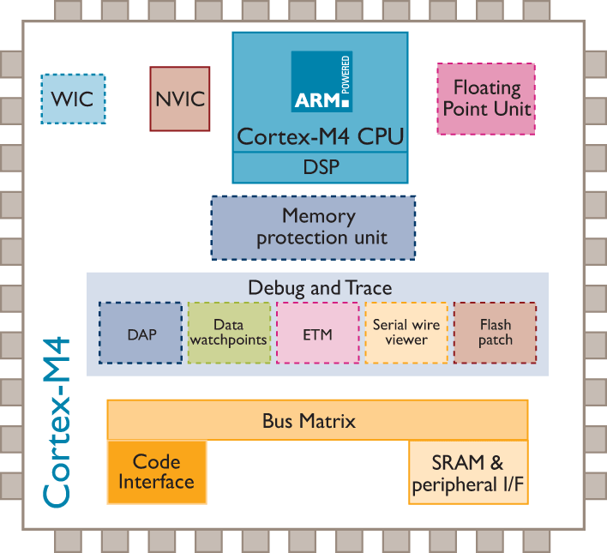
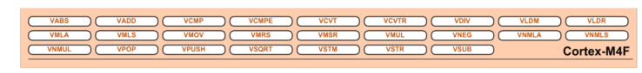
Floating-Point Unit (FPU)
The FPU provides floating-point computation functionality that is compliant with the IEEE 754 standard
Enables conversions between fixed-point and floating-point data formats, and floating-point constant instructions
The Cortex-M4F FPU fully supports single-precision:
Add
Subtract
Multiply
Divide
Single cycle multiply and accumulate (MAC)
Square root
Modes of Operation...
Notes:
The Tiva C Series floating point unit supports single-precision adds, subtractions, multiplies, divides, single-cycle multiply and accumulate or MAC and square roots.
The figure it the bottom shows the additional instructions added to the base Cortex M4 set by the floating-point unit .

Slide 85
Modes of Operation
There are three different modes of operation for the FPU:
Full-Compliance mode – In Full-Compliance mode, the FPU processes all operations according to the IEEE 754 standard in hardware. No support code is required.
Flush-to-Zero mode – A result that is very small, as described in the IEEE 754 standard, where the destination precision is smaller in magnitude than the minimum normal value before rounding, is replaced with a zero.
Default NaN (not a number) mode – In this mode, the result of any arithmetic data processing operation that involves an input NaN, or that generates a NaN result, returns the default NaN. ( 0 / 0 = NaN )
FPU Registers...
Notes:
There are three different modes of operation for the floating point unit: Full compliance , flush to zero and default Nan.
Full compliance mode is where the floating point unit processes all operations according to the IEEE-754 standard in hardware. There is no additional support code required.
In flush-to-zero mode, a very small result as described in the IEEE-754 standard is replaced with a zero. In most cases, that's probably what you want to do.
Nan stands for “not a number”. In Default Nan mode, the result of any arithmetic data processing operation that involves an input that's not a number or that generates a result that's not a number, it will return the default NaN. If you perform a divide by zero, that's a Nan, or not a number.

Slide 86
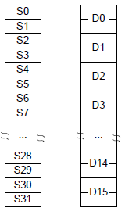
FPU Registers
Sixteen 64-bit double-word registers, D0-D15
Thirty-two 32-bit single-word registers, S0-S31
Usage...
Notes:
The floating point unit has sixteen 64-bit, double-word registers, D0 through D15 and thirty-two 32-bit, single-word registers, S0 through S31. The floating point unit is disabled from reset. You must enable it with a TivaWare API function call before you can use any floating point instructions. The processor must be in a privileged mode to read and write from the control register and the API performs this function.

Slide 87
FPU Usage
The FPU is disabled from reset. You must enable it* before you can use any floating-point instructions. The processor must be in privileged mode to read from and write to the Coprocessor Access Control (CPAC) register.
Exceptions: The FPU sets the cumulative exception status flag in the FPSCR register as required for each instruction. The FPU does not support user-mode traps.
The processor can reduce the exception latency by using lazy stacking*. This means that the processor reserves space on the stack for the FPU state, but does not save that state information to the stack.
* with a TivaWare API function call
CMSIS...
Notes:
The floating point unit sets the accumulative exception status flag in the exception register as required for each instruction. The floating point unit does not support any user type traps that you might write.
The processor can reduce the exception latency by using a technique called lazy stacking, which is support by a TivaWare API. Lazy stacking means that the processor reserves space on the stack for the state, but it doesn't save that state information to the stack unless it's necessary.

Slide 88
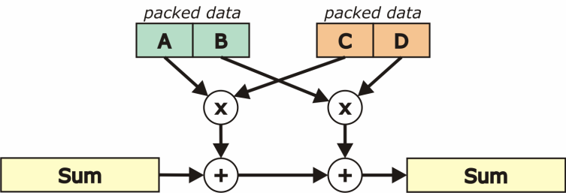
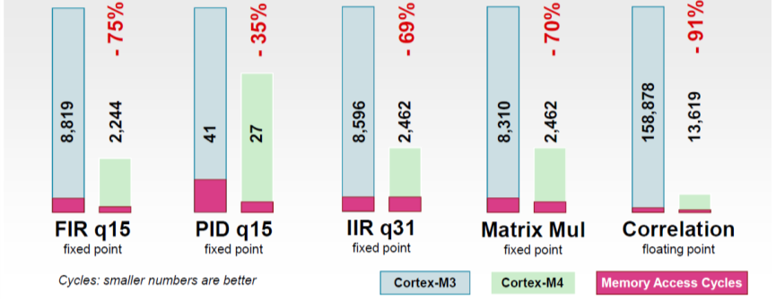
CMSIS* DSP Library Performance
* - ARM® Cortex™ Microcontroller Software Interface Standard
DSP Library Benchmark: Cortex M3 vs. Cortex M4 (SIMD + FPU)
Fixed-point ~ 2x faster
Floating-point ~ 10x faster
Source: ARM CMSIS Partner Meeting Embedded World, Reinhard Keil
Lab...
Notes:
ARM has developed the Cortex Microcontroller Software Interface Standard, or CMSIS. Included in CMSIS is a DSP library that you can use to create your own DSP-type functions.
Benchmarking the M4 vs. the M3, even in fixed point code, the M4 is about twice as fast as the M3. With the floating point unit, floating point code runs about ten times faster on the M4 than the M3.

Slide 89
Lab 9: FPU
USB Emulation Connection
Experiment with the FPU
Profile floating-point code
Agenda ...
Notes:
In lab 9, you'll experiment with using floating point code to generate a sign wave. You'll profile the code to determine how many CPU cycles it requires to execute.

Slide 90
Agenda
Introduction to ARM® Cortex™-M4F and Peripherals
Code Composer Studio
Introduction to TivaWare™, Initialization and GPIO
Interrupts and the Timers
ADC12
Hibernation Module
USB
Memory and Security
Floating-Point
BoosterPacks and grLib
Synchronous Serial Interface
UART
µDMA
Sensor Hub
PWM
LaunchPad Boards...
Notes:
The LaunchPad design first implemented with the MSP430 has been a success because of two major factors. One, it's inexpensive, and two, it's expandable. Expansion is accomplished through the booster pack connector. The Tiva LaunchPad implements an upgraded version called Booster Pack XL.
Texas Instruments offers some booster pack kits, but many more are offered by third parties. One of those third parties is Kentech, and you'll be using their LCD touchscreen booster pack in the lab. In order to get the most from the display, you'll learn about TivaWare's graphics library. That library includes functions for drawing images, text, and shapes on the screen, as well as implementing touchscreen buttons.

Slide 91
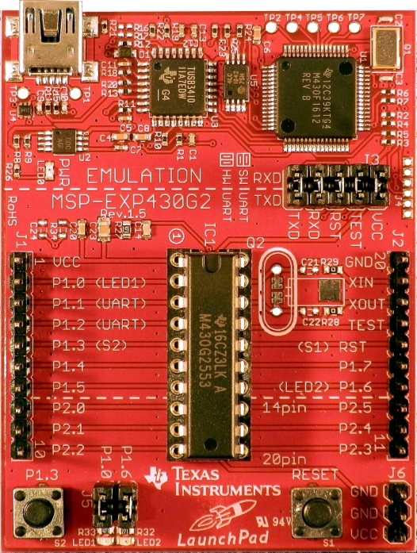

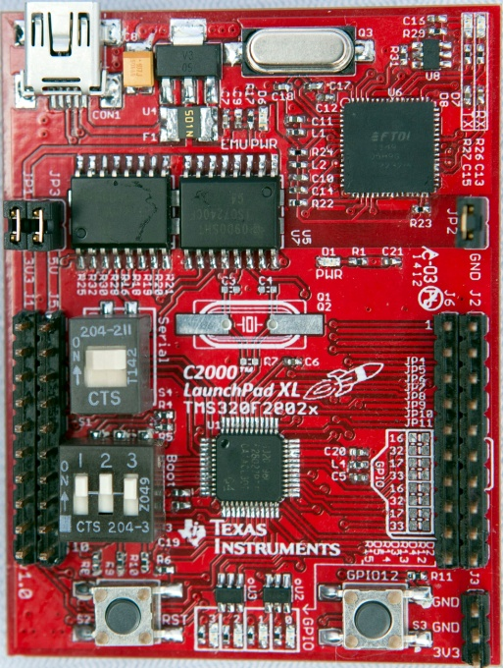
TI LaunchPad Boards
MSP430 $9.99US
Tiva C Series $12.99US
C2000 Piccolo $17.00US
BoosterPack Connectors...
Notes:
TI currently makes three LaunchPad style evaluation boards: the MSP430 for $4:30US, the Tiva LaunchPad board for $12.99US, and the C2000 Piccolo LaunchPad board for $17US.

Slide 92


BoosterPack Connectors
Original Format (MSP430)
VCC and Ground
14 GPIO
Emulator Reset and Test
Crystal inputs or 2 more GPIO
XL Format (Tiva C Series/C2000) is a superset of the original, adding two rows of pins with:
USB V_{BUS} and Ground
18 additional GPIO
Available Boosterpacks...
Notes:
Expandability is an important feature of the LaunchPad evaluation boards and this is accomplished through the booster pack connectors. The original format of the boosterpack connector was on the MSP430 launchpad. That format offered VCC and ground, as many as 14 GPIO pins..
The Tiva and the C2000 Piccolo boards utilize the XL format. This is a superset of the original, which adds two more rows of pins. You can see the outside rows of pins that are noted by J1 on the outside left and J2 on the outside right. They're joined by J3 and J4 just to the inside of both of them. This adds the USB voltage and ground and 18 additional GPIO.

Slide 93
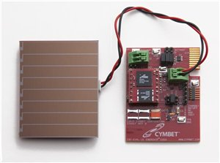
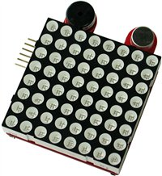








Some of the Available BoosterPacks
Solar Energy Harvesting
RF Module w/ LCD
TMP006 IR Temperature Sensor
Olimex 8x8 LED Matrix
Universal Energy Harvesting
Inductive Charging
Sub-1GHz RF Wireless
C5000 Audio Capacitive Touch
Capacitive Touch
Proto Board
TPL0401 SPI Digital Pot.
TPL0501 SPI Digital Pot.
Available Boosterpacks...
Notes:
Some of these boosterpacks are made by TI, like the energy harvesting, capacitive touch and digital potentiometer boards but most are created by third-parties.

Slide 94






Some of the Available BoosterPacks
Proto board
ZigBee Networking
OLED Display
LCD Controller Development Package
MOD Board Adapter
Click Board Adapter
Kentec LCD Display...
Notes:
To round out the overview, here are some additional boosterpacks created by third parties.

Slide 95

KenTec TouchScreen TFT LCD Display
Part# EB-LM4F120-L35
Designed for XL BoosterPack pinout
3.5” QVGA TFT 320x240x16 color LCD with LED backlight
Driver circuit and connector are compatible with 4.3”, 5”, 7” & 9”displays
Resistive Touch Overlay
grLib Overview...
Notes:
The booster pack we'll be using in the lab is the Kentec touchscreen TFT LCD display with LED backlight. It’s a three-and-a-half-inch QVGA screen with 320 by 240 pixel resolution and 16 colors. It's designed with the XL booster pack pin out.
The driver circuit and the connector are compatible with the 4.3-inch, 5-inch, 7-inch, and 9-inch displays from Kentec, so you can use the same boosterpack board and swap out the displays.

Slide 96

Graphics Library Overview
The Tiva C Series Graphics Library provides graphics primitives and widgets sets for creating graphical user interfaces on Tiva controlled displays.
Note that Tiva devices do not have an LCD interface. The interface to smart displays is done through serial or EPI ports.
The graphics library consists of three layers to interface your application to the display:
Your Application Code*
Widget Layer
Graphics Primitives Layer
Display Driver Layer*
* = user written or modified
grLib Overview...
Notes:
The Tiva graphics library provides you with graphics, primitives, and widgets for creating an entire graphic user interface on Tiva-controlled displays. Some designers will go all the way to using Linux on a machine just to get a better graphic user interface. Here, you can use a smaller, less expensive microcontroller and design your own GUI.
Note that none of the Tiva C Series devices presently have an LCD interface. The interface to smart displays is done through a serial or parallel port. The graphics library consists of three layers to interface your application to the display.
At the very bottom is the display driver layer. You will generally have to modify this code for your display.
We've had customers do this, and it usually takes them in the two to three day range to modify the display driver to fit with the display that they‘ve chosen.
The middle layer is the graphics primitives layer for drawing additional pieces to the screen.
At the very top of that is the widget layer. The widgets are for tying touchscreen elements to code-based interaction. Your application code can interface with any of the layers..

Slide 97
Graphics Library Overview
The design of the graphics library is governed by the following goals:
Components are written entirely in C except where absolutely not possible.
Your application can call any of the layers.
The graphics library is easy to understand.
The components are reasonably efficient in terms of memory and processor usage.
Components are as self-contained as possible.
Where possible, computations that can be performed at compile time are done there instead of at run time.
Display Driver...
Notes:
The design of the graphics library has been governed by the following goals:
- That the components have been written entirely in C except where absolutely not possible.
- That your application, can call any of the layers.
- That the graphics library is easy to understand, and the components are reasonable efficient in terms of memory and processor usage. Those two goals can be somewhat at odds with each other. Code can be so efficient that you can't understand it, and if you can't understand it, you're not going to be able to use it.
- That the components are as self-contained as they can be, and where possible, any of the computations that need to be performed will be performed at compile time instead of using up cycles on your CPU at run time.

Slide 98

Display Driver
Low level interface to the display hardware
Routines for display-dependent operations like:
Initialization
Backlight control
Contrast
Translation of 24-bit RGB values to screen dependent color map
Drawing routines for the graphics library like:
Flush
Line drawing
Pixel drawing
Rectangle drawing
User-modified Hardware Dependent Code
Connectivity of the smart display to the LM4F
Changes to the existing code to match your display (like color depth and size)
Graphics Primitives...
Notes:
Within the graphics library, the bottom layer is the display driver. This is the low-level interface to the display hardware.
Routines for display-dependent operations, like initializing the display, backlight control, contrast, translation of 24-bit RGB values from the primitives layer to the screen-dependent color map.
The display driver also contains low-level drawing routines, like flush, lines, pixels, and rectangle drawing.
Hardware-dependent code will require modification, like connection to the display, the color depth, size of the screen, etc.

Slide 99





Graphics Primitives
Low level drawing support for:
Lines, circles, text and bitmap images
Support for off-screen buffering
Foreground and background drawing contexts
Color is represented as a 24-bit RGB value (8-bits per color)
~150 pre-defined colors are provided
153 pre-defined fonts based on the Computer Modern typeface
Support for Asian and Cyrillic languages
Widgets...
Notes:
The middle layer in the graphics library is graphics primitives.
This layer provides drawing support for lines, circles, text, and bitmap images as well as support for off-screen buffering. Many times you don't want to write directly to the display and have the viewer see you doing it. Instead, you can write to an off-screen buffer and then swap and show that buffer.
Foreground and background drawing contexts are important so that you can put objects behind of or in front of each other.
Colors are represented as 24-bit RGB values and there are 150 predefined colors already provided in the library. Look in the Graphics Library User's Guide and you'll find those predefined colors in the back.
Also in the back of the user’s guide is a list of 153 predefined fonts based on the computer modern typeface. And as shown in the diagrams at the bottom of the screen, Asian and Cyrillic languages are supported.

Slide 100








Widget Framework
- Widgets are graphic elements that provide user control elements
- Widgets combine the graphical and touch screen elements on-screen with a parent/child hierarchy so that objects appear in front or behind each other correctly
Canvas – a simple drawing surface with no user interaction
Checkbox – select/unselect
Container – a visual element to group on-screen widgets
Push Button – an on-screen button that can be pressed to perform an action
Radio Button – selections that form a group; like low, medium and high
Slider – vertical or horizontal to select a value from a predefined range
ListBox – selection from a list of options
Special Utilities...
Notes:
Widgets are the top layer of the graphics library. Widgets are graphic elements that provide user control elements. They combine the graphical and the touchscreen elements on screen in a parent-child hierarchy so that objects appear in front or behind each other as they're supposed to. This hierarchy can extend multiple layers. It also determines which elements on the screen will be updated when you request an update.
Canvases provide you with a simple drawing surface on which you can place controls and graphical elements.
Checkboxes allow you to select and on select actions .
Containers provide you with a visual element to group you your widgets and controls together .
Pushbuttons provide you with an on-screen button that can be pressed .
Radio buttons allow you to select from a group .
Sliders, either vertical or horizontal allow you to graphically select a value from a predefined range .
Listboxes provide you with a list of selections that you can pick from .

Slide 101
Special Utilities
Utilities to produce graphics library compatible data structures
ftrasterize
Uses the FreeType font rendering package to convert your font into a graphic library format.
Supported fonts include: TrueType®, OpenType®, PostScript® Type 1 and Windows® FNT.
lmi-button
Creates custom shaped buttons using a script plug-in for GIMP. Produces images for use by the pushbutton widget.
pnmtoc
Converts a NetPBM image file into a graphics library compatible file.
NetPBM image formats can be produced by: GIMP, NetPBM, ImageMajik and others.
mkstringtable
Converts a comma separated file (.csv) into a table of strings usable by graphics library for pull down menus.
Lab...
Notes:
There are several utilities included in the graphics library that allow you to create compatible data structures that the library can understand .
Frasterize converts your font into a font that the graphics library can understand.
lmi-button creates custom shaped buttons using a GIMP plug-in . It will produce an image , for instance your company logo , for use by the push button widget . GIMP is an open source image manipulation tool.
pnmtoc converts a NetPBM image file into a file understandable by the graphics library . Several image manipulation tools handle the NetPBM image format including GIMP.
mkstringtable converts a comma separated file into a table of strings for use by the listbox widget .

Slide 102
Lab 10: Graphics Library
USB Emulation Connection
Connect Kentec Display
Experiment with demo project
Write graphics library code
Agenda ...
Notes:
In lab 10, you'll use the KenTec LCD touchscreen display on the LaunchPad board to experiment with graphics library. You'll write code that places an image, text, and shapes on the LCD. Then you'll experiment with the touchscreen by adding a rectangular button widget that controls the LED on the LaunchPad board.

Slide 103
Agenda
Introduction to ARM® Cortex™-M4F and Peripherals
Code Composer Studio
Introduction to TivaWare™, Initialization and GPIO
Interrupts and the Timers
ADC12
Hibernation Module
USB
Memory and Security
Floating-Point
BoosterPacks and grLib
Synchronous Serial Interface
UART
µDMA
Sensor Hub
PWM
Features...
Notes:
In this chapter, we’ll take a look at the synchronous serial interface . It supplies access to SPI , microwire and TI synchronous serial interfaces .

Slide 104
TM4C123GH6PM SSI Features
Four SSI modules. Each with:
Freescale SPI, MICROWIRE or TI Synchronous Serial interfaces
Master or Slave operation
Programmable bit clock rate and pre-scaler
Programmable data frame size from 4 to 16-bits
Separate Tx and Rx FIFOs ( 8 x16-bits )
Interrupts and µDMA support
Block Diagram ...
Notes:
The TM4C123GH6PM has four independent SSI modules . Each module supports SPI, microwire and TI synchronous serial interfaces. In each mode it can operate as a master or slave and has programmable clock bit rates and pre scalar.
frame sizes are programmable from 4 to 16 bits . The module has a separate transmit and receive fifo’s that are eight 16 bit words in length.
Interrupts and DMA transfers are supported .

Slide 105

SSI Block Diagram
Signal Pinout (n = 0 to 3) …
SSInClk: SSI Module n Clock
SSInFss: SSI Module n Frame Signal
SSInRx: SSI Module n Receive
SSInTx: SSI Module n Transmit
Interrupts...
Notes:
Each SSI module has four pins , although these pins are heavily multiplexed with other functions . These four pins include the clock , frame signal , received and transmit lines .

Slide 106
SSI Interrupts
Single interrupt per module, cleared automatically
Interrupt conditions:
Transmit FIFO service (when the transmit FIFO is half full or less)
Receive FIFO service (when the receive FIFO is half full or more)
Receive FIFO time-out
Receive FIFO overrun
End of transmission
Receive DMA transfer complete
Transmit DMA transfer complete
Interrupts on these conditions can be enabled individually
Your handler code must check to determine the source of the SSI interrupt and clear the flag(s)
Operation...
Notes:
Each SSI module can provide an interrupt to the CPU. Since this is a single source interrupt, it will be cleared automatically . Conditions under which an interrupt can be generated are:
When the transmit fifo is half full or less
When the receive fifo is half full or more
If the receive fifo times out
If the receive fifo overruns
At the end of the transmission
When the receive or transmit DMA transfer is complete
You can and able interrupts to occur on these conditions individually . Your interrupt handler code must check to determine the source of the SSI interrupt and clear the appropriate flags .

Slide 107
SSI µDMA Operation
Separate channels for Tx and Rx
When enabled, the SSI will assert a DMA request on either channel when the Rx or Tx FIFO can transfer data
For Rx channel: A single transfer request is made when any data is in the Rx FIFO. A burst transfer request is made when 4 or more items is in the Rx FIFO.
For Tx channel: A single transfer request is made when there is at least one empty location in the Tx FIFO. A burst transfer request is made when 4 or more slots are empty.
1
2
Signal Formats...
Notes:
There are separate channels for transmit and received.
When enabled , the SSI will assert a DMA request for the receive or transmit fifo to transfer data .
For the receive channel, a single transfer request will be made when any data is in the receive fifo . A burst transfer request will be made when four or more items are in the receive fifo .
For the transmit channel , a single transfer request will be made when there is at least one empty location in the transmit fifo . A burst transfer request we’ll be made when four or more of the slots are empty .

Slide 108


Freescale SPI Signal Formats
Four wire interface. Full duplex.
SSIFss acts as chip select
Inactive state and clock phasing are programmable via the SPO and SPH bits (SSI_FRF_MOTO_MODE_0-3 parameter)
SPO = 0: SSIClk low when inactive. SPO = 1: high
SPH = 0: Data is captured on 1st SSIClk transition. SPH = 1: 2nd
SPO = 0
SPH = 0
Single
Transfer
SPO = 0
SPH = 1
Single
Transfer
TI Signal Formats ...
Notes:
The Freescale SPI signal format is a full duplex four wire interface . The inactive state of the clock and the clock phasing are programmable via the SPO and SPH bits .

Slide 109


TI Synchronous Serial Signal Formats
Three wire interface
Devices are always slaves
SSIClk and SSIFss are forced low and SSITx is tri-stated when the SSI is idle
Single
Transfer
Continuous
Transfer
Microwire Signal Formats...
Notes:
The TI synchronous serial format is a three wire interface where devices are always slaves .The clock and frame signal pins will be forced low and the transmit pin will be tri-stated when the SSI module is idle .

Slide 110


Microwire Signal Formats
Four wire interface
Similar to SPI, except transmission is half-duplex
Master – Slave message passing technique
Single
Transfer
Continuous
Transfer
Lab...
Notes:
The microwire signal format is a four wire interface similar to the SPI port except that transmission is half duplex .

Slide 111


Lab 11 : SPI Bus and the Olimex LED Boosterpack
USB Emulation Connection
Carefully install pin-modified Olimex BoosterPack
Run faces program (SoftSSI)
Carefully install proto-board modified Olimex BoosterPack
Create program to utilize SSI SPI
Agenda ...
Notes:
Lab 11 utilizes the Olimex LED array BoosterPack . This BoosterPack was originally designed to operate with first generation MSP430 LaunchPads . Unfortunately, the location of the SPI ports has changed since then . You’ll run the faces example that uses a software SSI to communicate with the changed pins. Modifying the BoosterPack will allow us to utilize the hardware SSI and create a program that will run using the LED array.

Slide 112
Agenda
Introduction to ARM® Cortex™-M4F and Peripherals
Code Composer Studio
Introduction to TivaWare™, Initialization and GPIO
Interrupts and the Timers
ADC12
Hibernation Module
USB
Memory and Security
Floating-Point
BoosterPacks and grLib
Synchronous Serial Interface
UART
µDMA
Sensor Hub
PWM
Features...
Notes:
In this chapter we’ll take a look at the basic functions of the UART port and its FIFO. In the lab we’ll initialize the port and use both polling and interrupts to echo data to the PC host across the emulators’ virtual COM port.

Slide 113
UART Features
Separate 16x8 bit transmit and receive FIFOs
Programmable baud rate generator
Auto generation and stripping of start, stop, and parity bits
Line break generation and detection
Programmable serial interface
5, 6, 7, or 8 data bits
even, odd, stick, or no parity bits
1 or 2 stop bits
baud rate generation, from DC to processor clock/16
Modem flow control on UART1 (RTS/CTS)
IrDA and EIA-495 9-bit protocols
µDMA support
Block Diagram...
Notes:
The TM4C123GH6PM includes 8 UART ports. Each of these ports features:
Separate 16 x 8-bit transmit and receive FIFOs
A programmable baud rate generator
Automatic generation and removal of the start, stop and parity bits
Line break generation and detection
A choice of 5 to 8 data bits, multiple parity types and 1 or 2 stop bits
Modem and flow control
IrDA and EIA-495 9-bit protocols
DMA support with separate transmit and receive channels

Slide 114

Block Diagram
Basic Operation...
Notes:
Note the two external pins on the right. Tiva C Series pins are highly multiplexed with other functions. Also note the transmit and receive FIFOs are integral to the module itself.

Slide 115
Basic Operation
Initialize the UART
Enable the UART peripheral, e.g.
SysCtlPeripheralEnable(SYSCTL_PERIPH_UART0);
SysCtlPeripheralEnable(SYSCTL_PERIPH_GPIOA);
Set the Rx/Tx pins as UART pins
GPIOPinConfigure(GPIO_PA0_U0RX);
GPIOPinConfigure(GPIO_PA1_U0TX);
GPIOPinTypeUART(GPIO_PORTA_BASE, GPIO_PIN_0 | GPIO_PIN_1);
Configure the UART baud rate, data configuration
ROM_UARTConfigSetExpClk(UART0_BASE, ROM_SysCtlClockGet(), 115200,
UART_CONFIG_WLEN_8 | UART_CONFIG_STOP_ONE |
UART_CONFIG_PAR_NONE));
Configure other UART features (e.g. interrupts, FIFO)
Send/receive a character
Single register used for transmit/receive
Blocking/non-blocking functions in driverlib:
UARTCharPut(UART0_BASE, ‘a’);
newchar = UARTCharGet(UART0_BASE);
UARTCharPutNonBlocking(UART0_BASE, ‘a’);
newchar = UARTCharGetNonBlocking(UART0_BASE);
Interrupts...
Notes:
The basic steps for initializing the UART are as follows:
Enable the UART peripheral
Configure the transmit and receive pins for the UART function
Configure the baud rate and data set up of the UART
Configure any other UART features like interrupt generation and FIFO usage
Now the port is ready to send and receive characters. In this UART design, a single data register is used for both the transmit and receive function. The peripheral driver library supports both blocking and non blocking APIs for writing and reading the data register.

Slide 116
UART Interrupts
Single interrupt per module, cleared automatically
Interrupt conditions:
Overrun error
Break error
Parity error
Framing error
Receive timeout – when FIFO is not empty and no further data is received over a 32-bit period
Transmit – generated when no data present (if FIFO enabled, see next slide)
Receive – generated when character is received (if FIFO enabled, see next slide)
Interrupts on these conditions can be enabled individually
Your handler code must check to determine the source of the UART interrupt and clear the flag(s)
FIFOs...
Notes:
Each UART module can provide an interrupt to the CPU. Since this is a single source interrupt, it will be cleared automatically . Conditions under which an interrupt can be generated are:
An overrun error
A break error
An incorrect parity
A framing error
A receive timeout when the fifo is not empty and no data is received during 32 bit times
When a transmit is attempted and no data is present to be transmitted
When a character is received
Interrupts on all these conditions can be enabled individually. Since these conditions are OR’d into a single interrupt to the CPU , the handler code must check to determine which of these conditions triggered the interrupt and clear the appropriate flags .

Slide 117
Using the UART FIFOs
Transmit FIFO
FIFO Level Select
Both FIFOs are accessed via the UART Data register (UARTDR)
After reset, the FIFOs are enabled*, you can disable by resetting the FEN bit in UARTLCRH, e.g.
UARTFIFODisable(UART0_BASE);
Trigger points for FIFO interrupts can be set at 1/8, 1/4, 1/2,3/4, 7/8 full, e.g.
UARTFIFOLevelSet(UART0_BASE,
UART_FIFO_TX4_8,
UART_FIFO_RX4_8);
UART_FIFO_TX1_8
UART_FIFO_TX2_8
UART_FIFO_TX4_8
UART_FIFO_TX6_8
UART_FIFO_TX7_8
* Note: the datasheet says FIFOs are disabled at reset
stdio Functions...
Notes:
Both the transmit and receive fifo’s are accessed through the UART Data register .
While the datasheet indicates that the UART fifo’s are disabled at reset, basic configuration of the UART module re-enables this feature by default. They can easily be disabled if necessary.
Trigger points for the generation of UART interrupt can be set at the 1/8th, 1/4th, ½, ¾, 7/8 and full points.

Slide 118
UART “stdio” Functions
TivaWare “utils” folder contains functions for C stdio console functions:
c:\TivaWare\utils\uartstdio.h
c:\TivaWare\utils\uartstdio.c
Usage example:
UARTStdioInit(0); //use UART0, 115200
UARTprintf(“Enter text: “);
See uartstdio.h for other functions
Notes:
Use the provided interrupt handler UARTStdioIntHandler() code in uartstdio.c
Buffering is provided if you define UART_BUFFERED symbol
Receive buffer is 128 bytes
Transmit buffer is 1024 bytes
Other UART Features...
Notes:
TivaWare’s UART library includes standard I/O console functions for initialization, printf, get, flushing the FIFOs and others.
To use the functions you should use the interrupt handler provided in uartstdio.c

Slide 119
Other UART Features
Modem flow control on UART1 (RTS/CTS)
IrDA serial IR (SIR) encoder/decoder
External infrared transceiver required
Supports half-duplex serial SIR interface
Minimum of 10-ms delay required between transmit/receive, provided by software
ISA 7816 smartcard support
UnTX signal used as a bit clock
UnRx signal is half-duplex communication line
GPIO pin used for smartcard reset, other signals provided by your system design
LIN (Local Interconnect Network) support: master or slave
µDMA support
Single or burst transfers support
UART interrupt handler handles DMA completion interrupt
EIA-495 9-bit operation
Multi-drop configuration: one master, multiple slaves
Provides “address” bit (in place of parity bit)
Slaves only respond to their address
Lab...
Notes:
UART1 supports modem flow control with Request to Send and Clear to Send handshake signals.
Infrared, ISA7816 smartcard, Local Interconnect Network and EIA-495 support is part of all UART modules.
UART modules have separate transmit and receive channels for efficient transfers of data.

Slide 120
Lab 12: UART
USB Emulation Connection
Initialize UART and echo characters using polling
Use interrupts
Notes:
Lab 12 experiments with the UART module. On the LaunchPad, the UART port is connected to the emulation hardware which then connects thru the USB port to your PC. On the PC the UART connection will appear as a virtual COM port. The lab will initialize the UART and use polling and interrupts to echo characters.

Slide 121
Agenda
Introduction to ARM® Cortex™-M4F and Peripherals
Code Composer Studio
Introduction to TivaWare™, Initialization and GPIO
Interrupts and the Timers
ADC12
Hibernation Module
USB
Memory and Security
Floating-Point
BoosterPacks and grLib
Synchronous Serial Interface
UART
µDMA
Sensor Hub
PWM
Features...
Notes:
In this chapter we’ll take a look at the uDMA. The lab will use the uDMA to transfer arrays and then transfer data from and to the UART.

Slide 122
µDMA Features
32 channels
SRAM to SRAM , SRAM to peripheral and peripheral to SRAM transfers (no Flash or ROM transfers are possible)
Basic, Auto (transfer completes even if request is removed), Ping-Pong and Scatter-gather (via a task list)
Two priority levels
8, 16 and 32-bit data element sizes
Transfer sizes of 1 to 1024 elements (in binary steps)
CPU bus accesses outrank DMA controller
Source and destination address increment sizes: size of element, half-word, word, no increment
Interrupt on transfer completion (per channel)
Hardware and software triggers
Single and Burst requests
Each channel can specify a minimum # of transfers before relinquishing to a higher priority transfer. Known as “Burst” or “Arbitration”
Transfer types...
Notes:
The uDMA has 32 channels and offers SRAM to SRAM, SRAM to peripheral and peripheral to SRAM transfers. Because of the design of the internal buses, no flash or ROM transfers are possible.
Available transfer modes are basic , auto (where the transfer completes when the request is removed ), ping-pong and scatter gather with two priority levels. Element sizes can be 8,16 or 32 bits , while transfer sizes can be 1 to 1024 elements in binary steps .
The source and destination addresses can be incremented by either the size of the element , half word , word or no increment . The processor can be interrupted when the channel transfer is complete .
Both hardware and software can trigger a uDMA transfer. CPU bus access outranks the DMA controller .
Each channel can be configured with a with a minimum number of transfers to make before relinquishing control to a higher priority transfer. This is known as burst or arbitration. Requests can be single or burst .

Slide 123
Transfer Types
Basic
Single to Single
Single to Array
Array to Single
Array to Array
Auto
Same as Basic but the transfer completes even if the request is removed
Ping-Pong
Single to Array (and vice-versa). Normally used to stream data from a peripheral to memory. When the PING array is full the µDMA switches to the PONG array, freeing the PING array for use by the program.
Scatter-Gather
Many Singles to an Array (and vice-versa). May be used to read elements from a data stream or move objects in a graphics memory frame.
Block diagram...
Notes:
There are four types of DMA transfers implemented .
In the basic type , transfers include single to single , single to array , array to single and array to array .
The auto type is the same as the basic type but here the transfer will complete even if the request is removed . This is standard practice for software DMA requests .
The ping-pong type utilizes single to array and array to single transfers. This type is normally used when streaming data to or from a peripheral and an array in memory. For example, when the PING array is full of incoming data , the uDMA will switch to the PONG array, freeing the PING array for use by the program and vice versa.
The scatter-gather type collects many singles to an array and vice-versa . This can be used to read or insert elements in a data stream or move objects in a graphics memory buffer .

Slide 124

µDMA Block Diagram
Channels...
Notes:
In this block diagram, note the tight connection between system memory , the uDMA controller , the nested vectored interrupt controller and the CPU .

Slide 125


µDMA Channels
Each channel has 5 possible assignments made in the DMACHMAPn register
S = Single
B = Burst
SB = Both
Configuration...
Notes:
All 32 channels of uDMA are listed here . Each channel in the list has five possible assignments that can be made to it . This is significantly more flexible than most DMA channel assignments . Note the type of transfers can be single, burst or both .

Slide 126


Channel Configuration
Channel control is done via a set of control structures in a table
The table must be located on a 1024-byte boundary
Each channel can have one or two control structures; a primary and an alternate
The primary structure is for BASIC and AUTO transfers. Alternate is for Ping-Pong and Scatter-gather
Control Structure Memory Map
Channel Control Structure
Control word contains:
Source and Dest data sizes
Source and Dest addr increment size
# of transfers before bus arbitration
Total elements to transfer
Useburst flag
Transfer mode
Lab...
Notes:
Channel configuration for the uDMA is accomplished through a set of control structures placed in a table .
This table must be located on a 1K byte boundary .
Each channel can have one or two control structures ; a primary and an alternate. The p rimary structure is for basic and auto transfers . The alternate is for ping-pong and scatter gather transfers.
Note the channel control structure in the figure on the right . Contained within the structure is the source and destination pointers and a control word . The control word contains the source and destination data sizes, the source and destination address increment sizes, the number of transfers to be performed before bus arbitration can occur, the total number of elements to transfer , a flag to indicate whether a not to use burst transfers And finally what transfer mode to use .

Slide 127

Lab 13: Transferring Data with the µDMA
USB Emulation Connection
Perform an array to array memory transfer
Transfer data to and from the UART
Agenda ...
Notes:
Lab 13 we will use the uDMA to perform array to array transfers. Then you’ll experiment with transferring data to and from the UART.

Slide 128
Agenda
Introduction to ARM® Cortex™-M4F and Peripherals
Code Composer Studio
Introduction to TivaWare™, Initialization and GPIO
Interrupts and the Timers
ADC12
Hibernation Module
USB
Memory and Security
Floating-Point
BoosterPacks and grLib
Synchronous Serial Interface
UART
µDMA
Sensor Hub
PWM
Features...
Notes:
In this chapter we’ll take a look at the TivaWare Sensor library and the Tiva Sensor Hub.

Slide 129

Tiva™ Sensor Hub BoosterPack Evaluation Kit Features
Motion & environmental sensing
BoosterPack XL connectors (compatible with earlier BoosterPack connectors)
EM board connectors (for TI’s wireless RF evaluation kits)
2 buttons & 2 LEDs
Example applications for each unique sensor
“Air” Mouse (PC HID) example demonstrates sensor fusion
CCS, Keil, IAR, & Mentor Embedded IDEs supported
TivaWare DriverLib under TI BSD-style license
Runs on Tiva TM4C123G and LM4F120 LaunchPads. HW compatible with MSP430 & C2000 LaunchPads
MSRP $49.99 USD
BOOSTXL-SENSHUB
TMP006...
Notes:
The Tiva Sensor Hub Boosterpack features 9 axes of motion and multiple environmental sensors. Boosterpack XL connectors allow direct connection with the TM4C123GXL and LM4F120GXL LaunchPads and hardware compatibility with other LaunchPad boards. EM connectors are provided to allow boards like the CC3000 WiFi or other TI RF connectivity boards to be attached. The board adds two buttons and two LEDs when connected to the LaunchPad.
Unique applications are provided for each sensor and an airmouse application demonstrates fusion of the motion sensor inputs.
Support is provided for CCS, Keil, IAR and Sourcery Codebench IDE’s.
The Tivaware for C Series Sensor Library is distributed for use using BSD style licensing.
Cost of the Tiva Sensor Hub is $50US.

Slide 130
TI TMP006 Infrared Temperature Sensor
No contact temperature measurement
-40C to 125C measurement range
240uA supply current
2.2 to 7V supply
I2C interface (address 0x41)
Host calculates observed temperature
BMP180...
Notes:
U1 is TI’s TMP006 Infrared temperature sensor. This no-contact device can measure temperatures over a -40 to 125 degree centigrade range. The supply current is 240uA and the supply voltage can be between 2.2 and 7 volts. The device has an I²C interface with address 0x41. During operation, the ambient temperature of the IR pile and the observed temperature of the target are communicated over the serial interface, These two measurements are then used by a sensor library API to calculate the actual temperature of the target.

Slide 131
Bosch BMP180 Digital Pressure Sensor
-500 to 9000m Mean Sea Level (1100 to 300hPa)
Temperature sensing for altitude compensation
1.8 – 3.6V supply
5uA supply current at 1 sample/sec
Very low noise
Multiple modes for power/accuracy tradeoff
I2C interface (address 0x77)
Host calculates altitude
MPU9150...
Notes:
U2 is the Bosch BMP180 digital pressure sensor. It has a measurement range of -500 to 9000 meter mean sea level and a temperature sensor for altitude compensation. Supply current is 5uA at 1 sample per second and the supply voltage can be between 1.8 and 3.6 volts. The sensor is designed for very low noise and has multiple sampling modes to trade off between power and accuracy. The device has an I²C interface with address 0x77. A sensor library API calculates the altitude from the raw pressure and temperature data.

Slide 132
Invensense MPU-9150 9-axis Motion Sensor
3-axis MEMS accelerometer
3-axis MEMS gyroscope
3-axis MEMS magnetometer
16-bit gyroscope and accelerometer resolution
13-bit magnetometer resolution
I2C interface (address 0x68)
2.375 to 3.465V supply
MEMS = Micromechanical system
ISL29023...
Notes:
U3 is the Invensense MPU-9150 9-axis motion sensor. It combines three MEMs sensors in a single package: a 16-bit resolution 3 axis accelerometer, a 16-bit resolution 3-axis gyroscope and a 13-bit 3 axis magnetometer or compass. The device has an I²C interface with address 0x68. Supply voltage is between 2.375 and 3.465 volts.

Slide 133
Intersil ISL29023 Ambient & Infrared Light Sensor
16-bit resolution
50 & 60Hz flicker rejection
1.7 to 3.63V supply
I2C interface (address 0x44)
HW (BoosterPack XL pin) and SW Interrupts on light levels
SHT21...
Notes:
U4 is the Intersil ISL29023 Ambient and Infrared light sensor. The device has 16-bit resolution plus 50 and 60Hz flicker rejection to eliminate florescent bulb noise. Supply voltage is 1.7 to 3.63 volts. The device has an I²C interface with address 0x44. The device can provide interrupts, both hardware and software at programmed light levels.

Slide 134
Sensirion SHT21 Humidity & Ambient Temperature Sensor
8/12-bit humidity resolution
12/14-bit temperature resolution
2.1 to 3.6V supply
I2C interface (address 0x40)
Slots in board for air circulation
Orientation Kinematics
Notes:
U5 is the Sensirion SHT21 Humidity and Ambient temperature sensor. Humidity is measured with 8 or 12-bit resolution while temperature is measured with 12 or 14-bit resolution. The supply voltage can be between 2.1 and 3.6 volts. The device has an I²C interface with address 0x40. Slots are provided in the board for air circulation.

Slide 135

Orientation Kinematics
The Direct Cosine Matrix (DCM) algorithm combines multiple axes of motion data into a single set of Euler angles for roll, pitch and yaw. The final calculated position is :
Less prone to drop-out
Of higher accuracy than the best individual sensor
The DCM algorithm calculates the orientation of a rigid body, in respect to the rotation of the earth by using rotation matrices. The rotation matrices are related to the Euler angles, which describe the three consecutive rotations needed to describe the orientation
The three sensors used in the algorithm are:
3 axis accelerometer (measures earth’s gravity field minus acceleration)
3 axis magnetometer (measures earth’s magnetic field)
3 axis gyroscope (measures angular velocity)
DCM Algorithm...
Notes:
The direct cosine matrix or DCM algorithm is used to combine or fuse the multiple axes into a single set of Euler angles representing the orientation of the body with respect to the earth. The final calculated orientation is less prone to drop-out and of higher accuracy than the best individual sensor. Rotational matrices and vector math are used by the sensor library APIs to calculate these angles.
The three sensors used in this algorithm are all within the Invensense device. The 3 axis accelerometer measures the gravitational field of earth minus any acceleration. The 3 axis magnetometer measures earth’s magnetic field and the 3-axis gyroscope measures angular velocity.

Slide 136

DCM Algorithm
The gyroscope is the primary sensor
Unaffected by the gravitational or magnetic field
Prone to drift
The accelerometer is used as an orientation reference in the X and Z axes
Compensates for roll and pitch errors
The magnetometer is used to calculate reference vector in the Y axis
Compensates for yaw errors
Proportional feedback removes the gyro’s drift
X
Roll
Z
Pitch
Y
Yaw
Air Mouse Example...
Notes:
In the DCM algorithm the gyroscope is the primary sensor. It is unaffected by earth’s gravity or magnetic field, but any gyroscope is prone to drift over time. The accelerometer provides orientation in the X and Z axes and compensates for roll and pitch errors. The magnetometer provides a reference vector in the Y axis and compensates for yaw errors. The magnetometer and accelerometer are used to calculate a proportional feedback to remove the drift of the gyroscope.

Slide 137




Air Mouse Example
The Invensense MPU-9150 provides raw acceleration, angular velocity and magnetic field measurements.
All 9 axes are fused and filtered using a complimentary direct cosine matrix or DCM algorithm into Euler angles for roll, pitch and yaw.
Roll and pitch are used to perform the mouse movements.
Raw angular velocities and accelerations are used to interpret gestures
Angles are calculated 100 times per second
Lab ...
Notes:
The air mouse example demonstrates the DCM algorithm in use by creating a human interface device computer mouse that can be used to move the on-screen cursor.
The Invensense sensor provide 9 axes of measurements which are then fused and filtered using the DCM algorithm to calculate the Euler angles to roll, pitch and yaw.
The roll and pitch angles are used to perform the mouse movements.
Angular velocities and accelerations are used to interpret gestures.
The angles and movements are calculated 100 times per second.

Slide 138

Lab 14a: Air Mouse
Reset Button
USB Emulation Port
Power Switch
USB H/D/OTG Port
Program the airmouse.bin binary into the MCU’s flash memory using LM Flash Programmer
Install the Sensor Hub BoosterPack
Experiment with the Air Mouse example
Sensor Library ...
Notes:
In lab14a you’ll install the sensor hub onto your LaunchPad board and then program the airmouse binary file into flash memory using the LM Flash Programmer. Then you can experiment with the application.

Slide 139

TivaWare™ Sensor Library Contents
Drivers for the I²C port and each sensor
Functions for manipulating the magnetometer readings
DCM Algorithm
comp_dcm.c/h reads the sensors and applies the DCM algorithm to the data
Vector operations
VectorAdd()
VectorCrossProduct()
VectorDotProduct()
VectorScale()
Sensor Library Usage...
Notes:
The sensor library contained in TivaWare has the following features:
It has drivers for the I2C port and all five sensors. It has functions for manipulating and correcting the compass readings.
The comp_dcm example reads the sensors and applies the DCM algorithm to the data.
The library contains several APIs for easily handling vector operations.

Slide 140
TivaWare™ Sensor Library Usage
The Sensor library is a consistent API with this general flow for all sensors
It’s easy to leverage the library for custom I²C sensors
For instance, to interface with the TMP006:
Initialize I²C pins and I²C peripheral normally
Initialize the I²C driver I2CMInit()
Initialize the TMP006 TMP006Init()
Configure the TMP006 TMP006ReadModifyWrite()
Read data from the TMP006 TMP006DataRead()
Convert data into temperature TMP006DataTemperatureGetFloat()
Examples...
Notes:
The sensor library provides a consistent programming model with the flow shown for all sensors, making it easy to leverage the library for other, custom I²C sensors.
The example shown is for the TMP006 IR temperature sensor. First, the I2C peripheral and its pins must be configured. Second, the I2C driver can be initialized. Third, the TMP006 can be initialized across the I2C connection. Fourth, the TMP006 can be properly configured. At this point data can be read from the device and converted into a temperature reading.

Slide 141

TivaWare™ Sensor Hub Examples
airmouse
fuses motion data into mouse and keyboard events
compdcm_mpu9150
basic data gathering from the MPU-9150
drivers
for buttons and LEDs
humidity_sht21
periodic measurements of humidity
light_isl29023
uses measurements of ambient visible and IR light to control the “white” LED
pressure_bmp180
periodic measurements of air pressure and temperature
temperature_tmp006
periodic measurements of ambient and IR temperatures to calculate actual object temperature
Lab...
Notes:
Included sensor hub examples are:
Airmouse which shows off the DCM algorithm
Compdcm_mpu9150 which demonstrates basic data gathering from the MPU-9150
Drivers for the buttons and LEDs
Humidity_sht21 to perform periodic measurements of humidity
Light_isl29023 that uses measurements of the ambient light to control the LaunchPad LED
Pressure_bmp180 to demonstrate air pressure and temperature measurements
Temperature_tmp006 to periodically measure and calculate the temperature of an object

Slide 142
Lab 14b: Sensor Library Usage
Reset Button
USB Emulation Port
Power Switch
USB H/D/OTG Port
Create a simple program to read the data from the ISL29023 light sensor
Display the results in Code Composer
Try out GUI Composer
Agenda ...
Notes:
In Lab14b you’ll write a sensor application from a blank page. You’ll use the ISL29023 and display the raw ambient light levels in Code Composer. Then you’ll experiment with visualizing the data using a new tool called Gui Composer.

Slide 143
Agenda
Introduction to ARM® Cortex™-M4F and Peripherals
Code Composer Studio
Introduction to TivaWare™, Initialization and GPIO
Interrupts and the Timers
ADC12
Hibernation Module
USB
Memory
Floating-Point
BoosterPacks and grLib
Synchronous Serial Interface
UART
µDMA
Sensor Hub
PWM
Features...
Notes:
In this chapter we’ll take a look at the PWM modules on the TM4C123GH6PM.

Slide 144




Pulse Width Modulation
Pulse Width Modulation (PWM) is a method of digitally encoding analog signal levels. High-resolution digital counters are used to generate a square wave of a given frequency, and the duty cycle of that square wave is modulated to encode the analog signal.
Typical applications for PWM are switching power supplies, motor control, servo positioning and lighting control.
TM4C123GH6PM PWM …
Notes:
Pulse width modulation or PWM is a widely used technique to digitally encode analog levels. High resolution counters are used to generate a square wave of a given frequency and the duty cycle of that wave is then modulated to encode the analog signal.
PWM is typically found in motor control, servo positioning, lighting and switching power supply applications.

Slide 145
TM4C123GH6PM PWM
The TM4C123GH6PM has two PWM modules
Each PWM module consists of:
Four PWM generator blocks
A control block which determines the polarity of the signals and which signals are passed to the pins
Each PWM generator block produces:
Two independent output signals of the same frequency or
A pair of complementary signals with dead-band generation (for H-bridge circuit protection )
Eight outputs total
Module Features …
Notes:
The TM4C123GH6PM has two PWM modules. Each PWM module consists of four generator blocks and a control block which determines the polarity of the signals and which signals get passed to the pins. Each of the generator blocks produces two independent output signals of the same frequency or a pair of complimentary signals with dead band generation. Dead band generation protects H bridge motor driver circuits. Four generator blocks times two outputs per generator provides eight total outputs or four pairs.

Slide 146

PWM Generator Features
One hardware fault input for low-latency shutdown
One 16-bit counter
Down or Up/Down count modes
Output frequency controlled by a 16-bit load value
Load value updates can be synchronized
Produces output signals at zero and load value
Two PWM comparators
Comparator value updates can be synchronized
Produces output signals on match
PWM signal generator
Output PWM signal is constructed based on actions taken as a result of the counter and PWM comparator output signals
Produces two independent PWM signals
Notes:
Each PWM generator has the following features:
A single 16 bit counter
Two PWM comparators
And a PWM signal generator
The 16 bit counter has down or up down count modes, and an output frequency which is controlled by a 16 bit load value. The load values updates can be synchronized with the output signal, between generators or between modules. The generator will produce an output signals at the zero and load values.
The PWM comparator update values can also be synchronized. And an output signal will be produced on a match.
The signal generator output is constructed based on actions taken as a result of the counter and the PWM comparator outputs to produce two independent PWM signals

Slide 147
PWM Generator Features (cont)
Dead-band generator
Produces two PWM signals with programmable dead-band delays suitable for driving a half-H bridge
Can be bypassed, leaving input PWM signals unmodified
Flexible output control block with:
PWM output enable of each PWM signal
Optional output inversion of each PWM signal (polarity control)
Optional fault handling for each PWM signal
Synchronization of timers in the PWM generator blocks
Synchronization of timer/comparator updates across the PWM generator blocks
Interrupt status summary of the PWM generator blocks
Can initiate an ADC sample sequence
Block diagram …
Notes:
The PWM generators also feature a dead band generator and a flexible output control block.
The dead band generator inserts programmable dead band delays into the two PWM output signals to protect half H bridge circuitry. The dead band generator can be bypassed leaving the PWM signals unmodified.
The output control block provides PWM output enable, polarity control and fault handling for each PWM signal. Timers can be synchronized across the generator blocks as can the timer / comparator updates. The control block provides an interrupt and status summary register for all the PWM blocks.
Each PWM generator can directly initiate an ADC sample sequence.

Slide 148

PWM Module Block Diagram
Notes:
Remember that there are two PWM modules per device. Note the control and status, interrupt and output control registers shown on the left. All four PWM generators go through the output control block before reaching the pins

Slide 149

PWM Generator Block Diagram
Lab …
Notes:
Each PWM module contains four generators, for a total of eight per device. Note the control, timer and comparator control registers on the left. For our lab, we will be primarily interested in the control, load and count registers.

Slide 150

Lab 15: PWM
USB Emulation Connection
VCC
GND
SIGNAL
Configure the PWM outputs and frequency
Add code to control a servo
Connect the servo to the LaunchPad
Test
Wrap-up ...
Notes:
In lab 15, we will configure one of the PWM outputs to generate a suitable frequency to control a radio control servo. We will then use the switches on the launchpad to change the duty cycle or pulse-width of the control pulse. Note that in order to run this lab, you will need to will acquire and modify a servo.

Slide 151

Thanks for Attending!
Make sure to take your LaunchPad boards, LCDs and workbooks with you
Please leave the TTO flash drives, meters and other instructor supplied hardware here
Please fill out the email survey when it arrives
Have safe trip home!

Slide 152
Presented by
Texas Instruments
Technical Training Organization
www.ti.com/training

